Slide 1
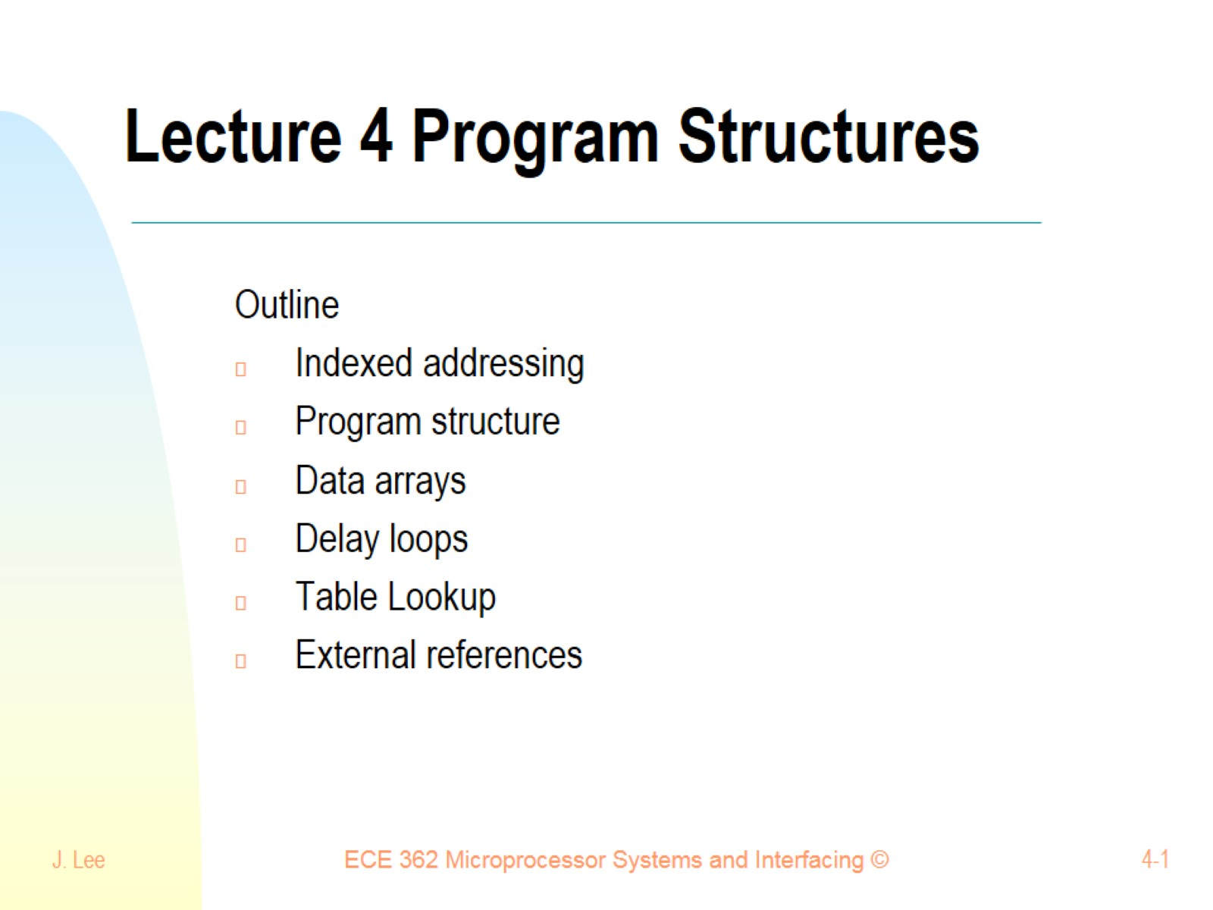
Lecture 4 Program Structures

Slide 2
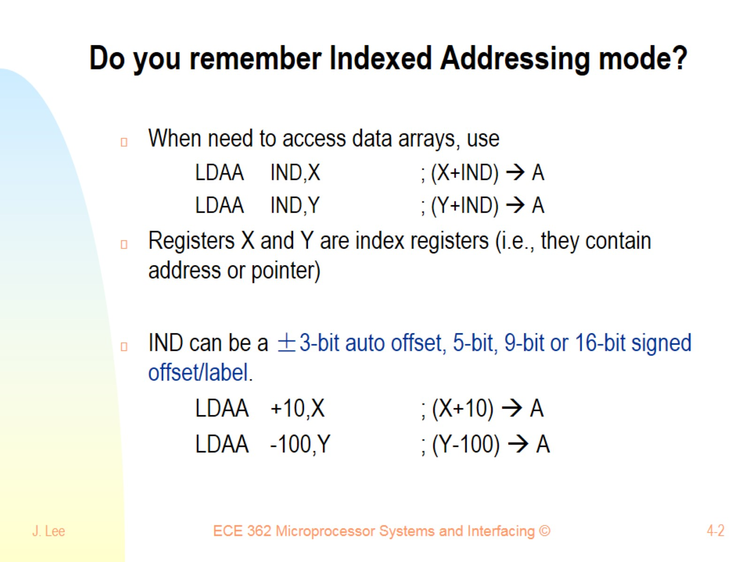
Do you remember Indexed Addressing mode?

Slide 3
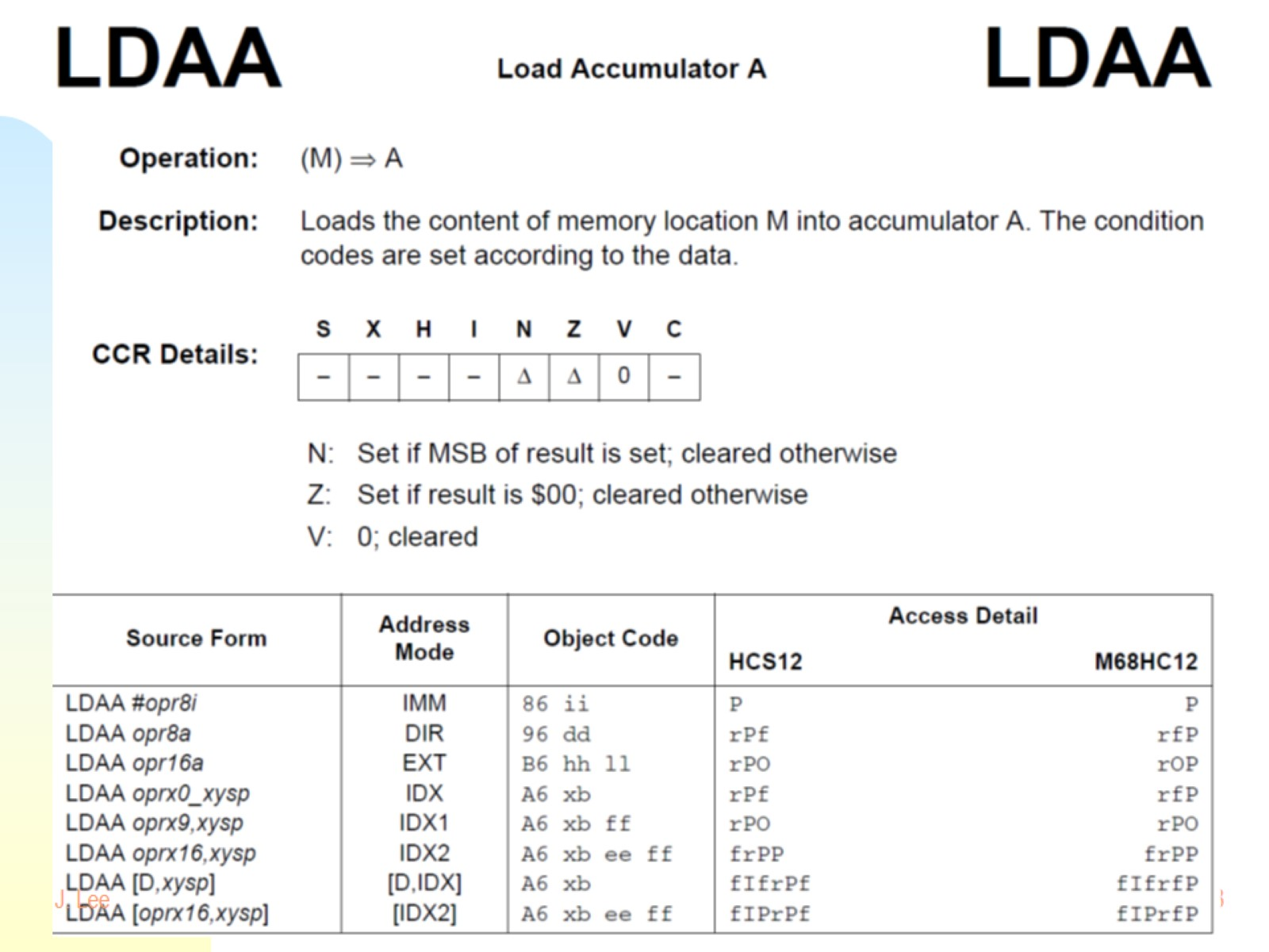

Slide 4
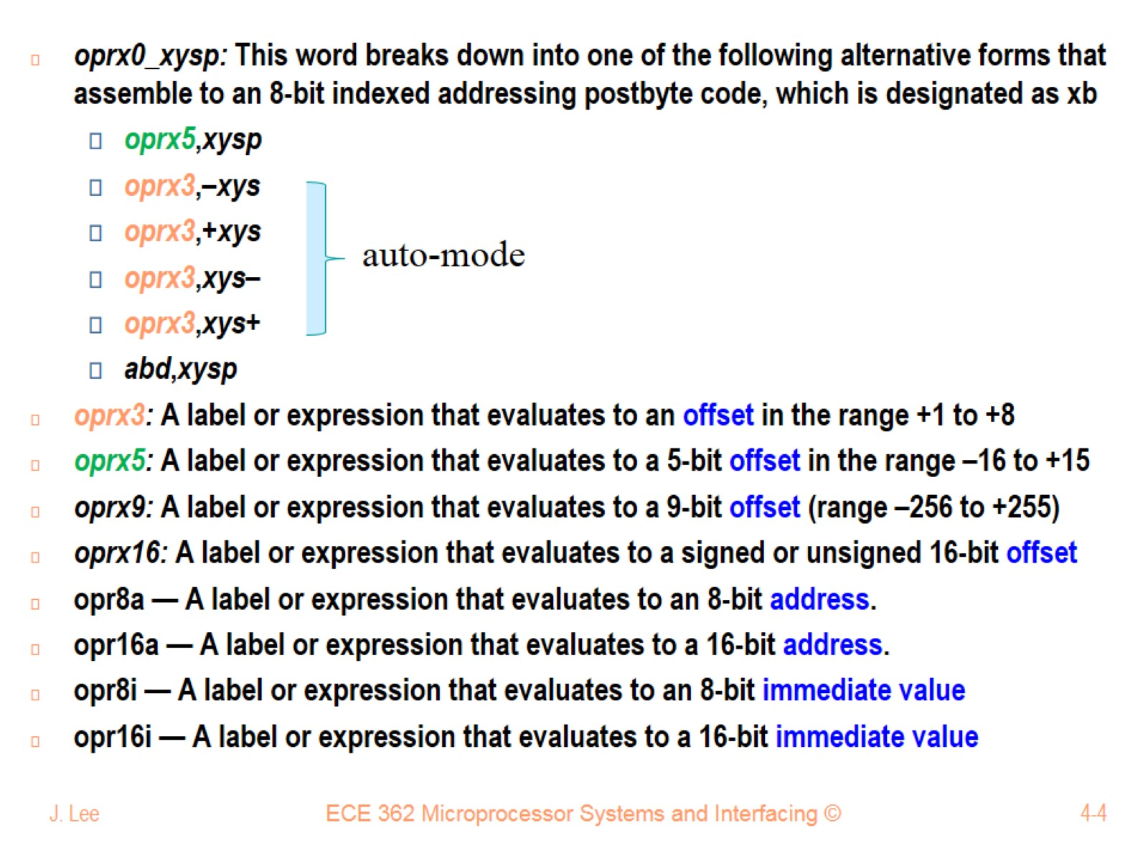

Slide 5
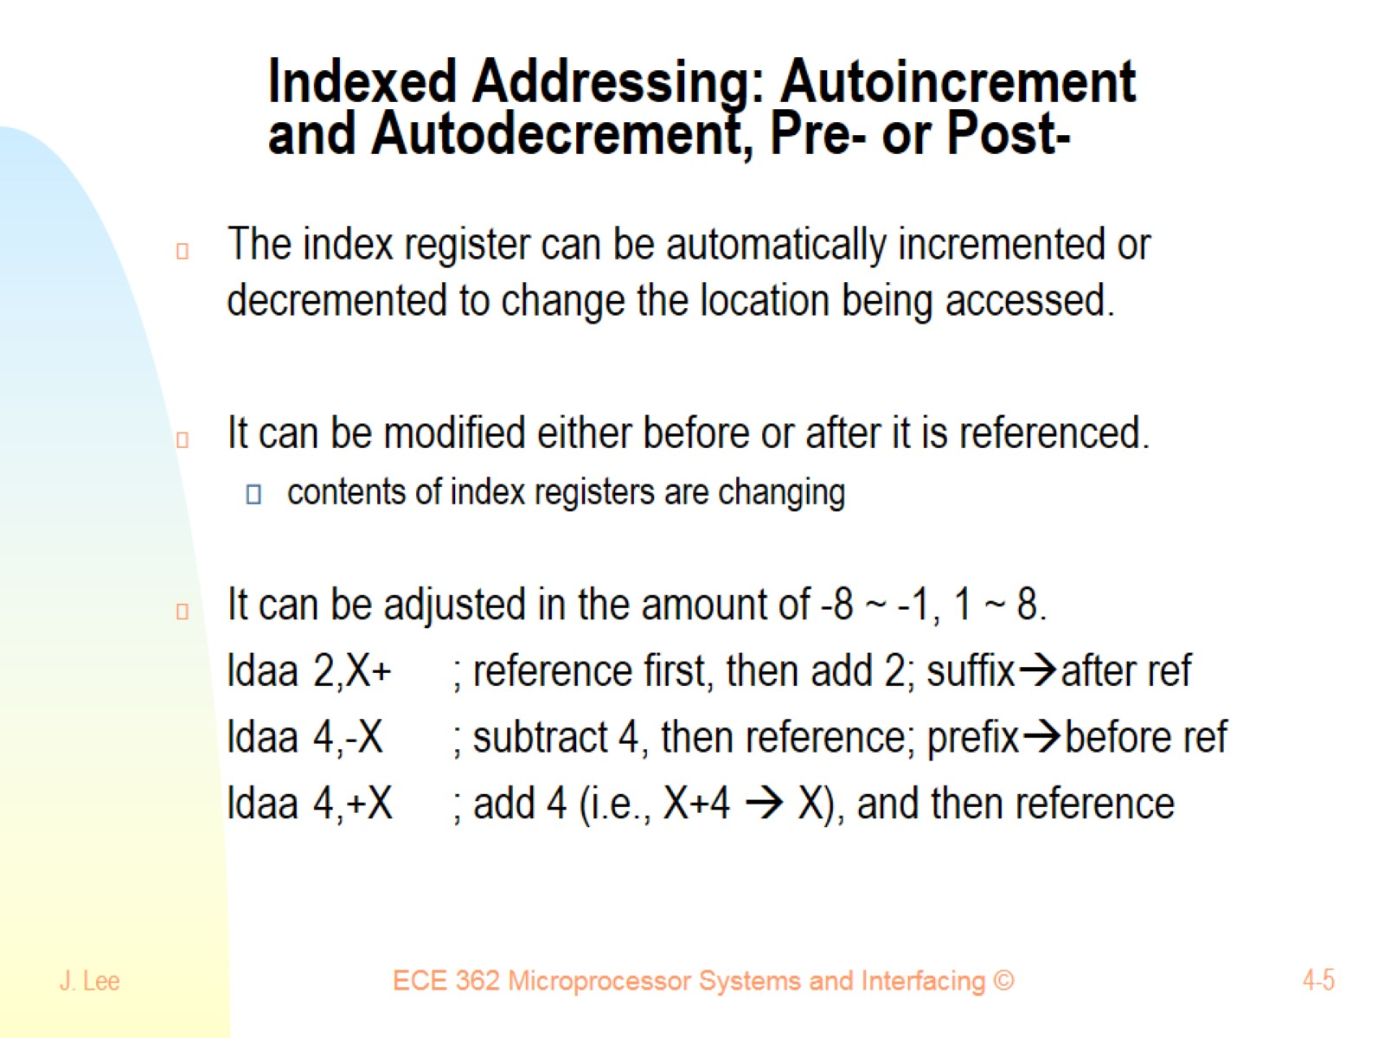
Indexed Addressing: Autoincrement and Autodecrement, Pre- or Post-

Slide 6
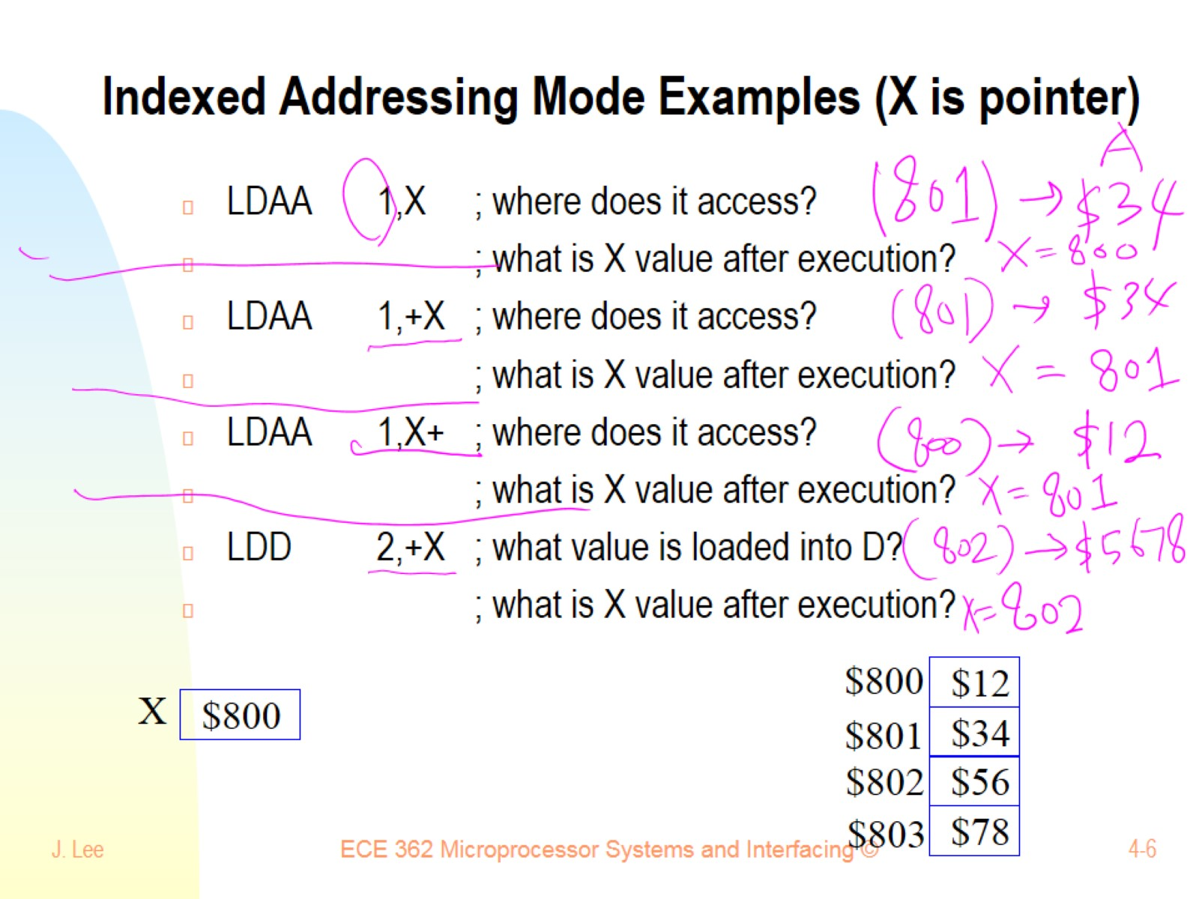
Indexed Addressing Mode Examples (X is pointer)

Slide 7
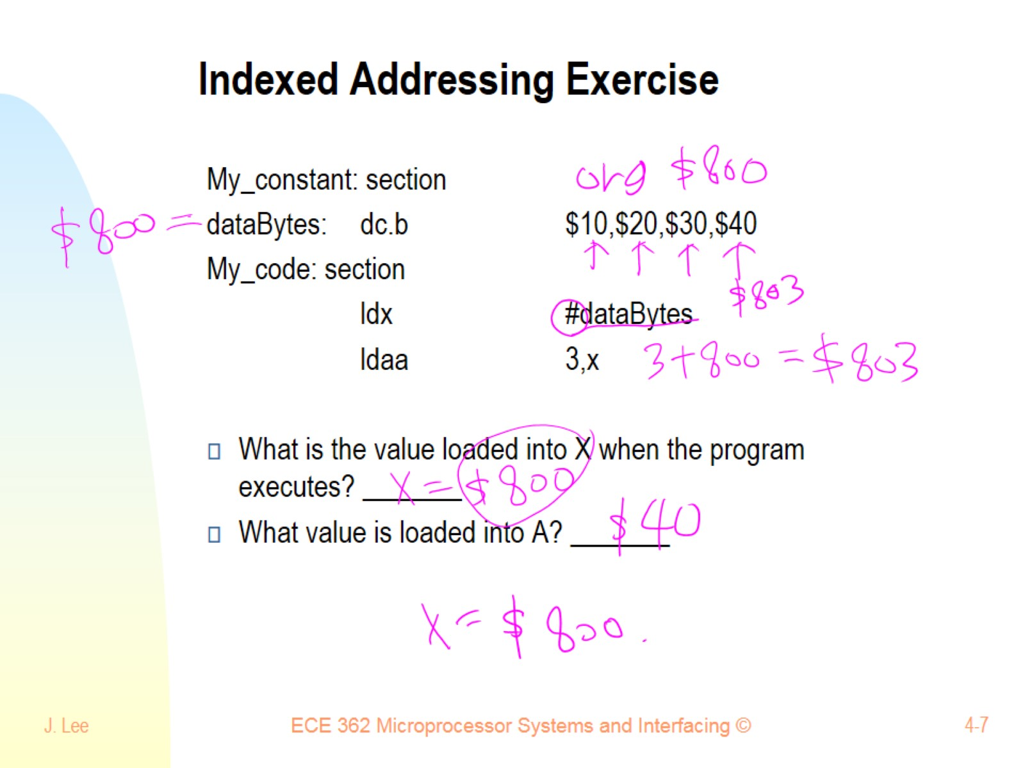
Indexed Addressing Exercise

Slide 8
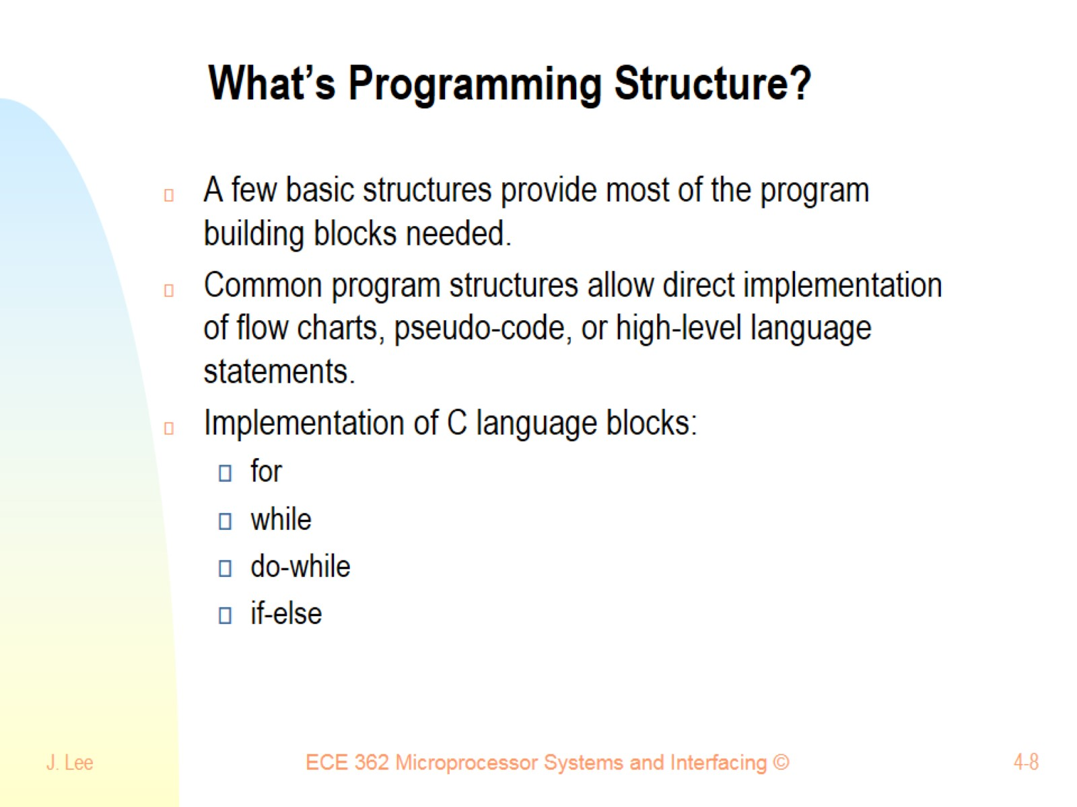
What’s Programming Structure?

Slide 9
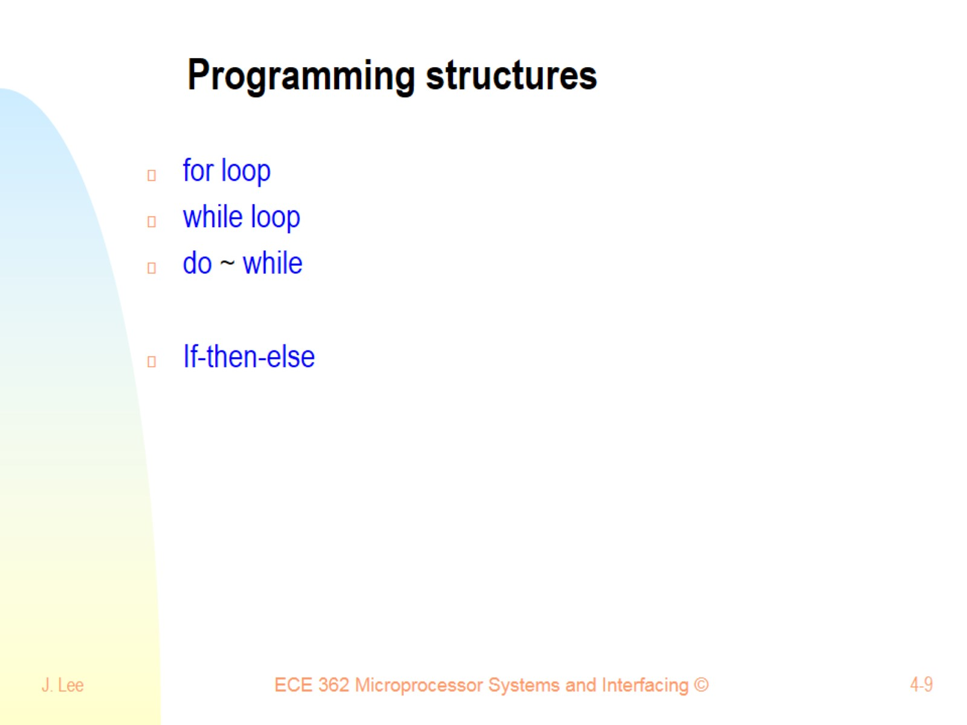
Programming structures

Slide 10
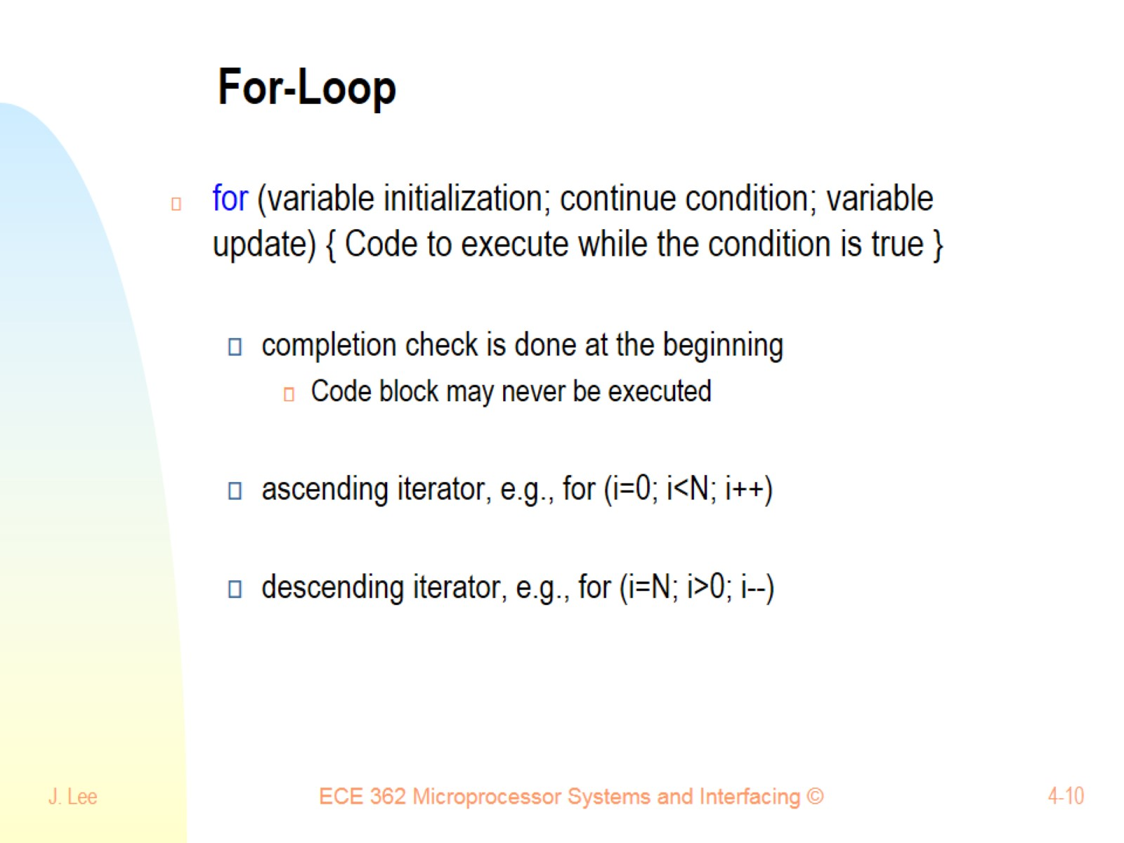
For-Loop

Slide 11
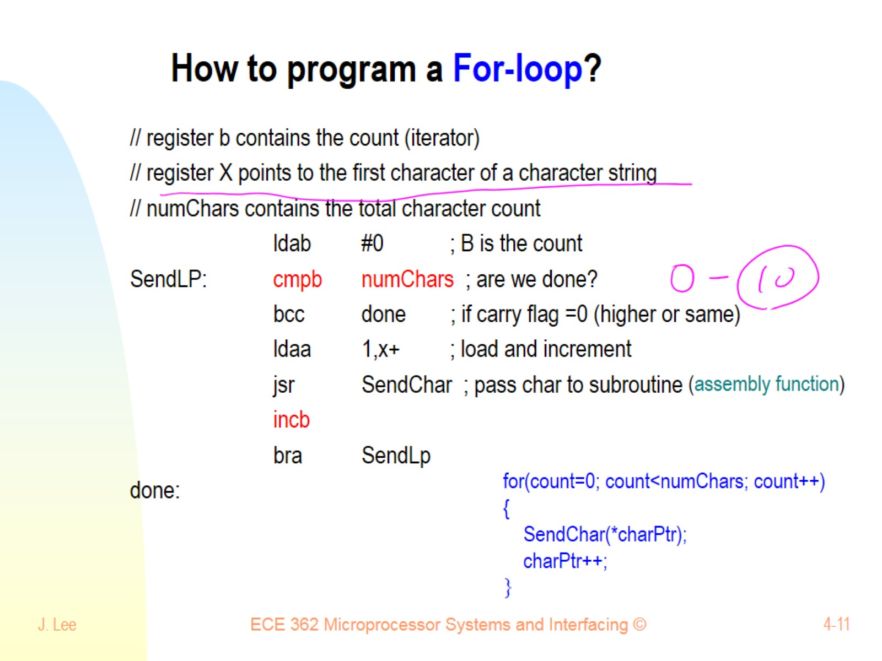
How to program a For-loop?

Slide 12
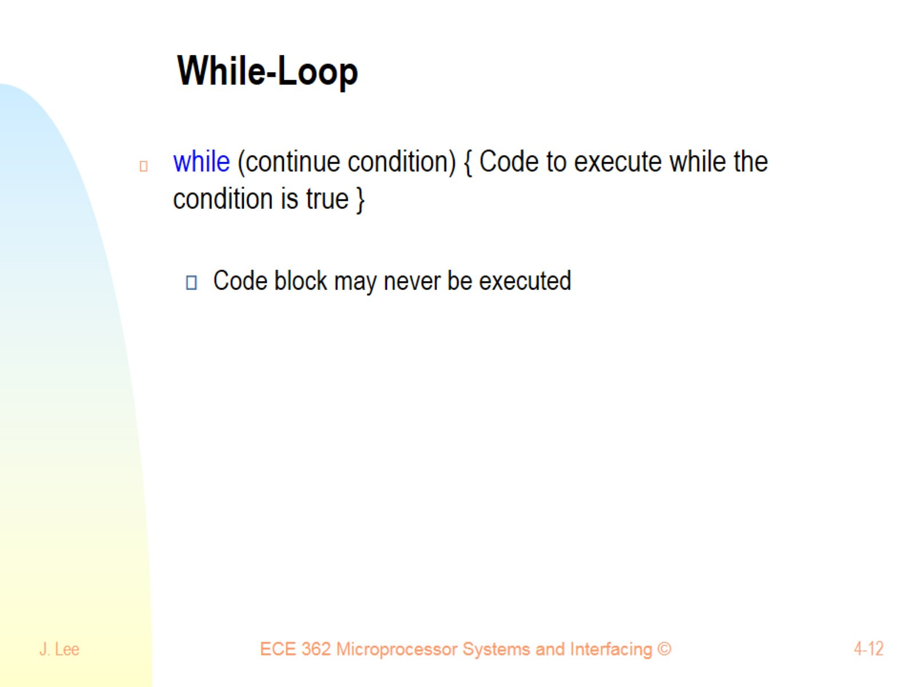
While-Loop

Slide 13
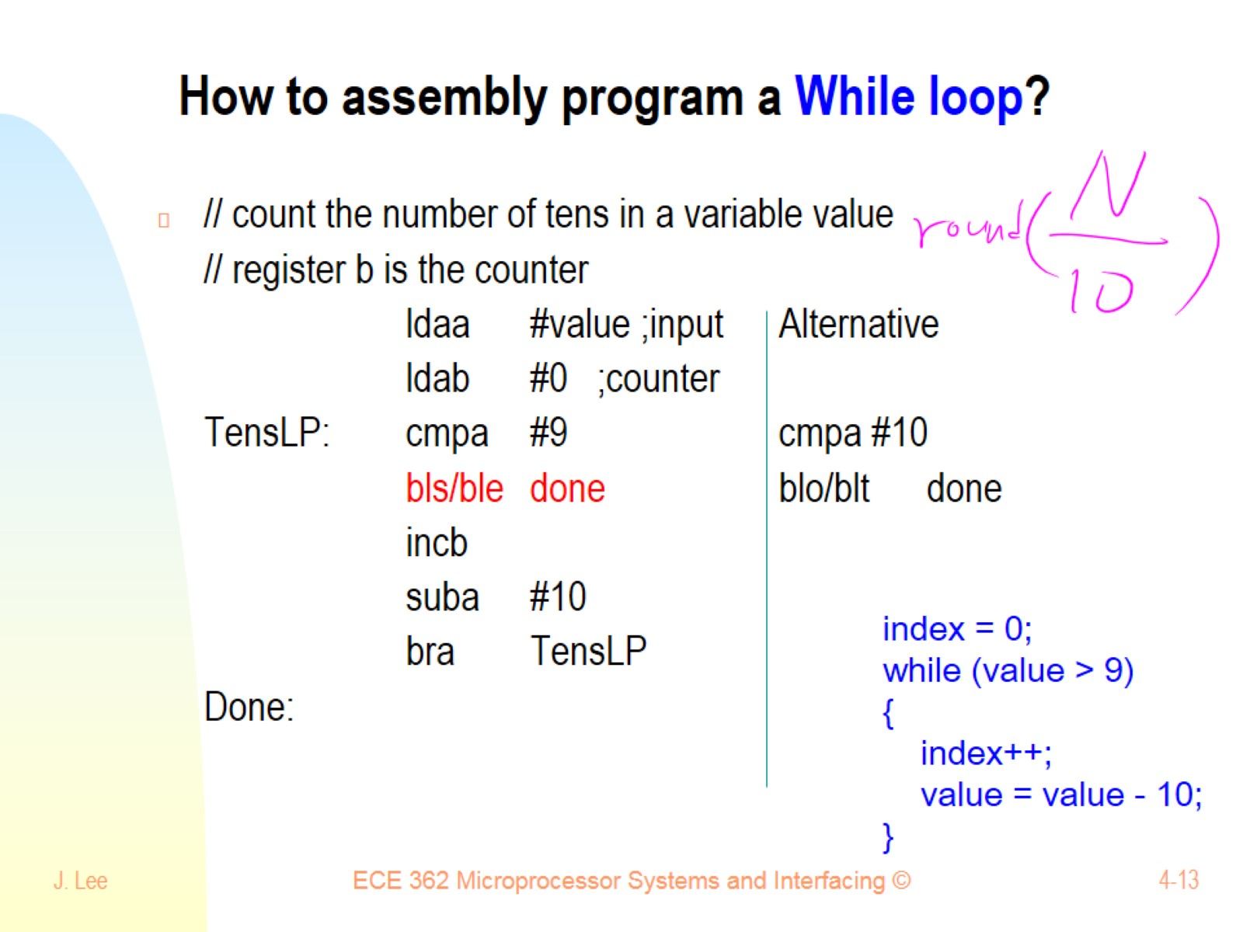
How to assembly program a While loop?

Slide 14
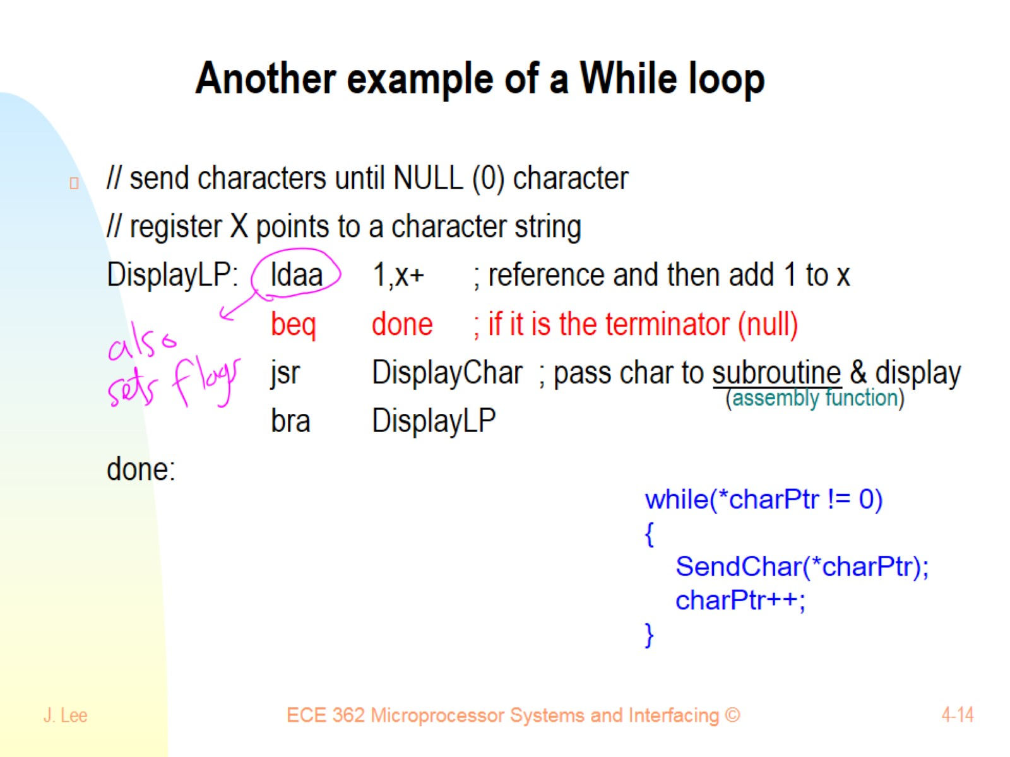
Another example of a While loop

Slide 15
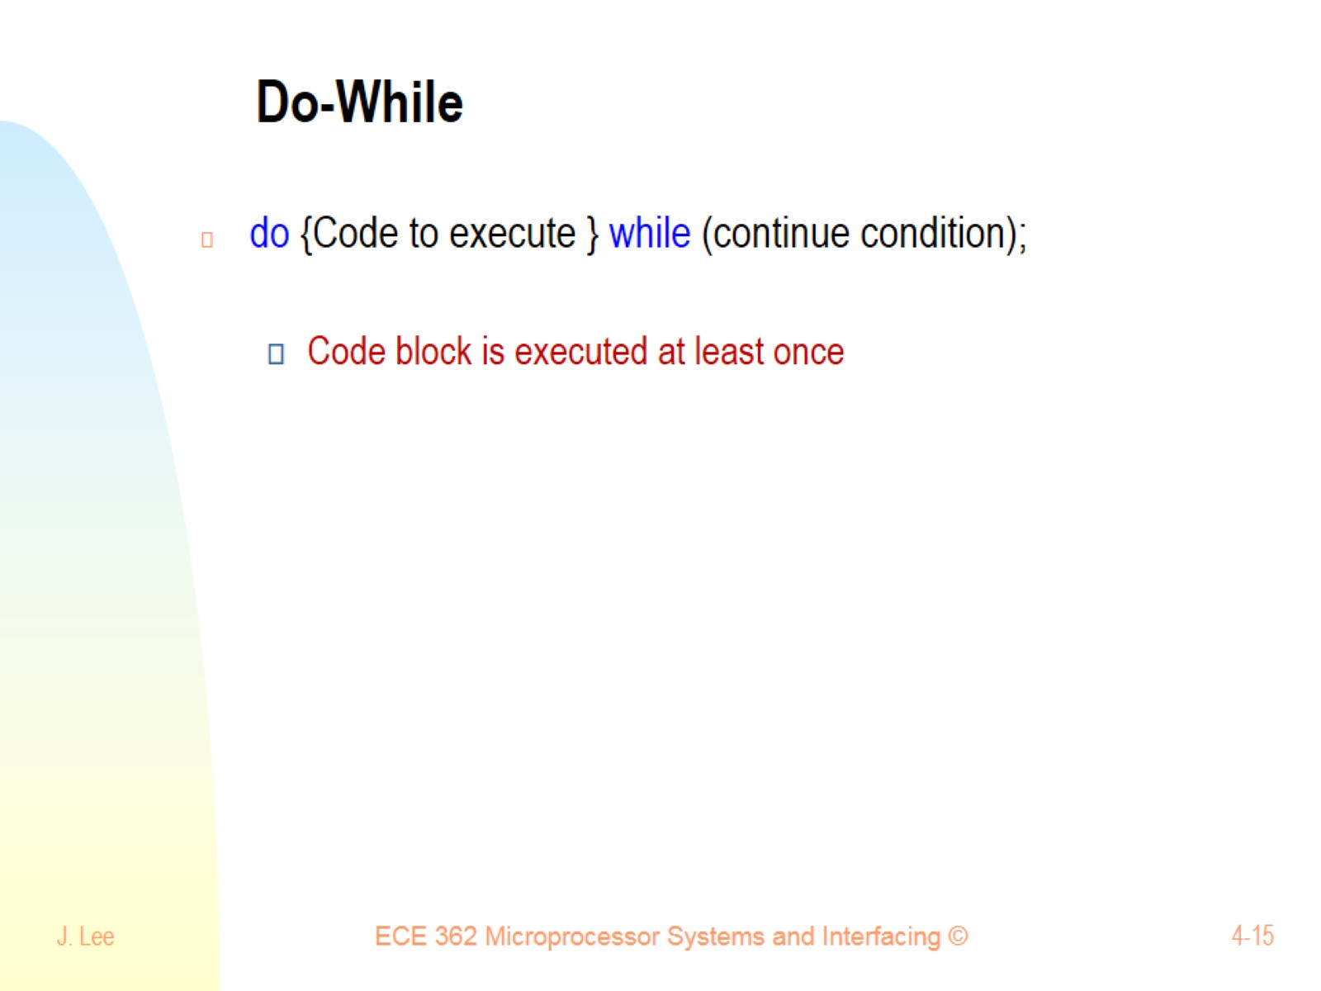
Do-While

Slide 16
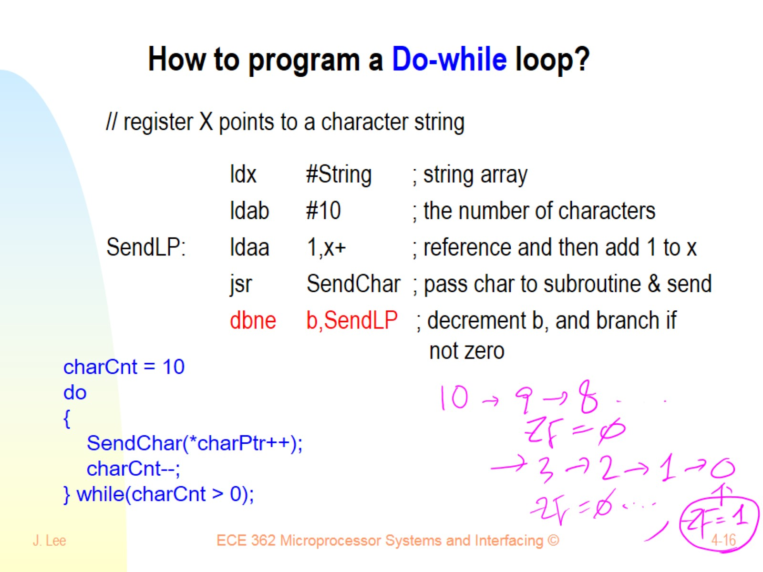
How to program a Do-while loop?

Slide 17
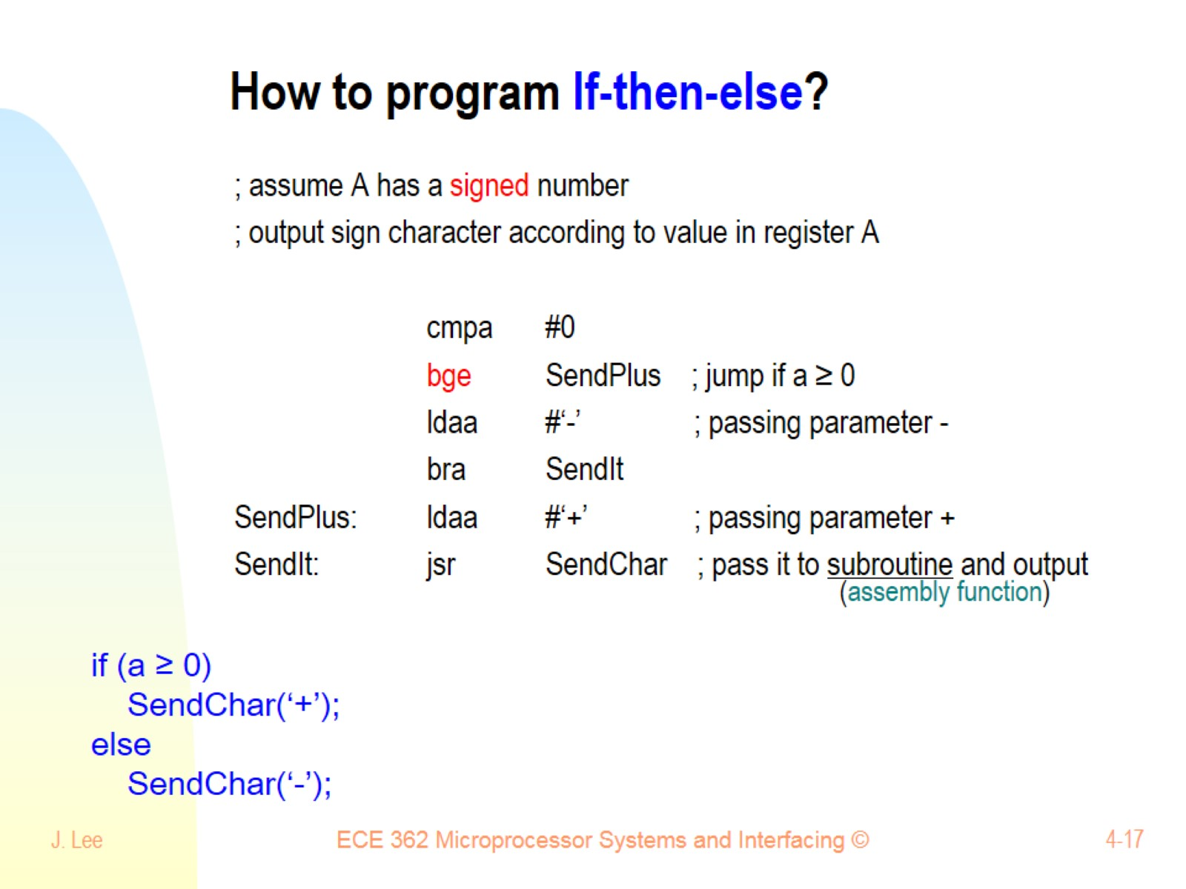
How to program If-then-else?

Slide 18
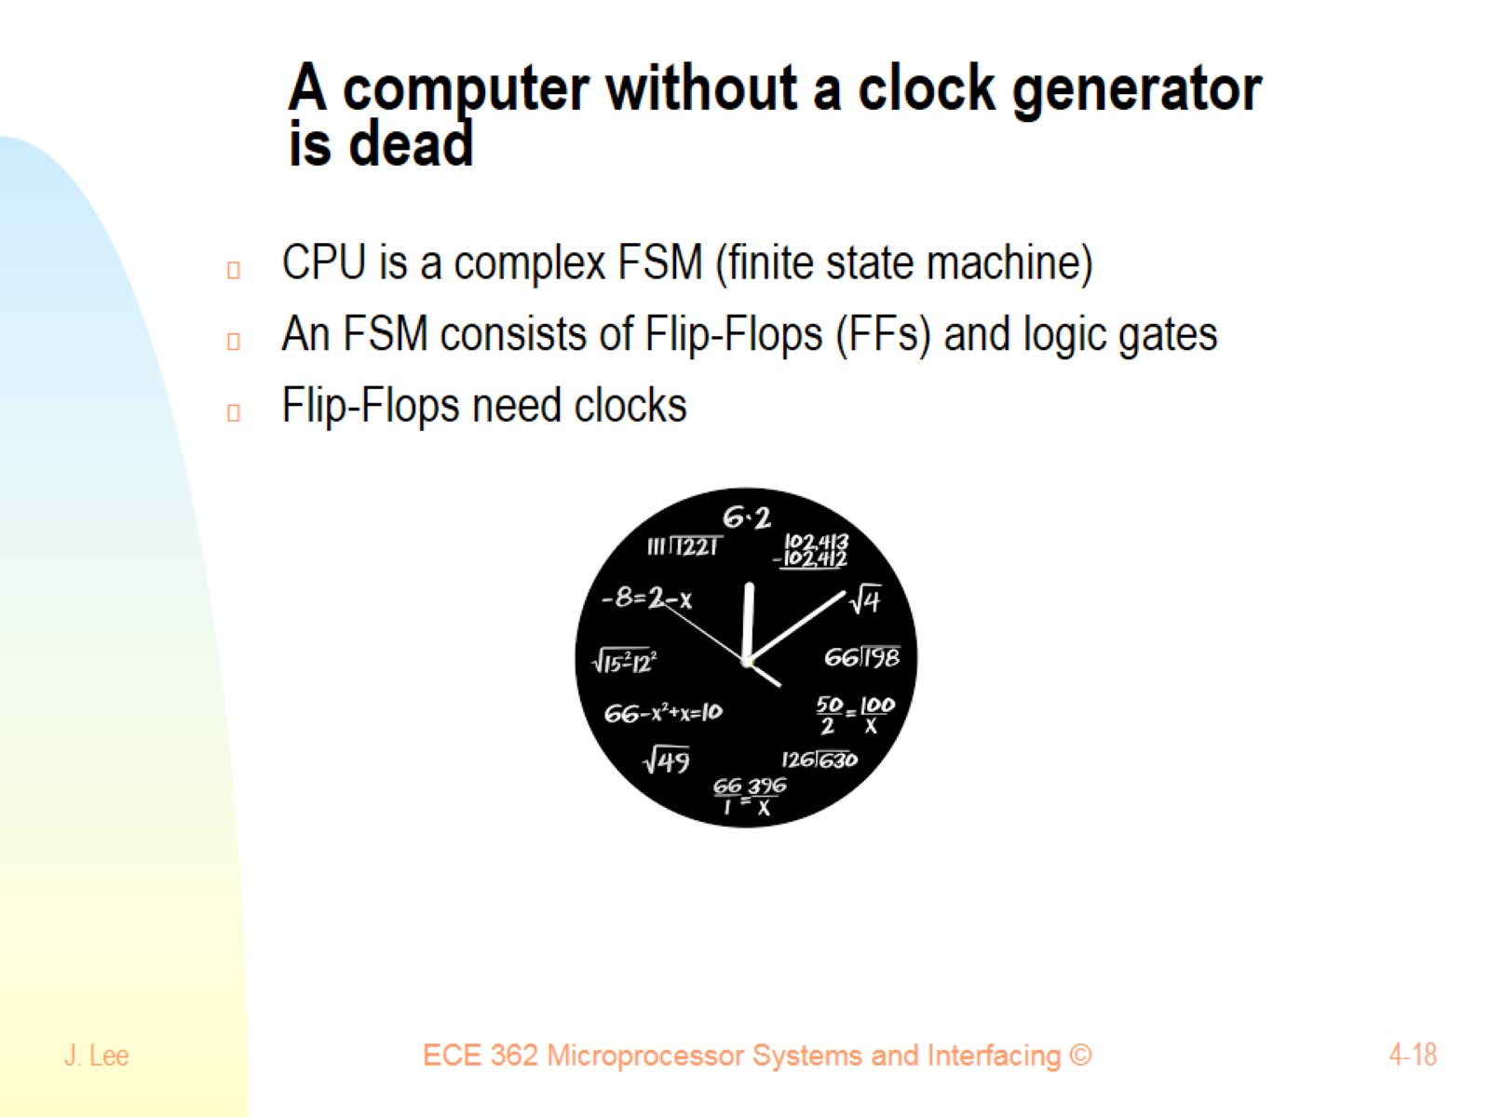
A computer without a clock generator is dead

Slide 19
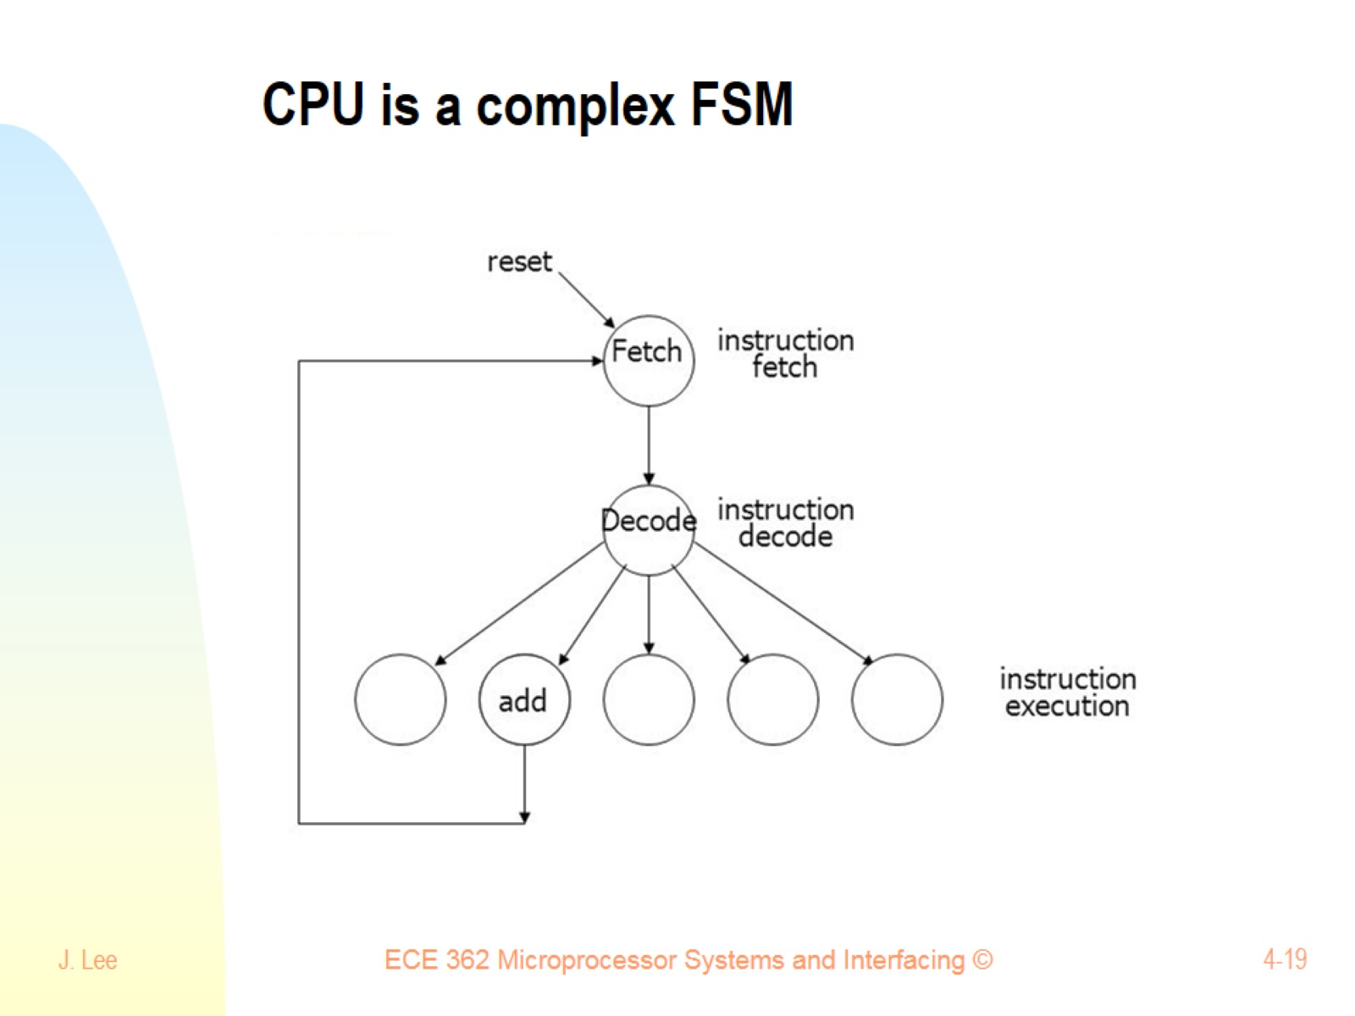
CPU is a complex FSM

Slide 20
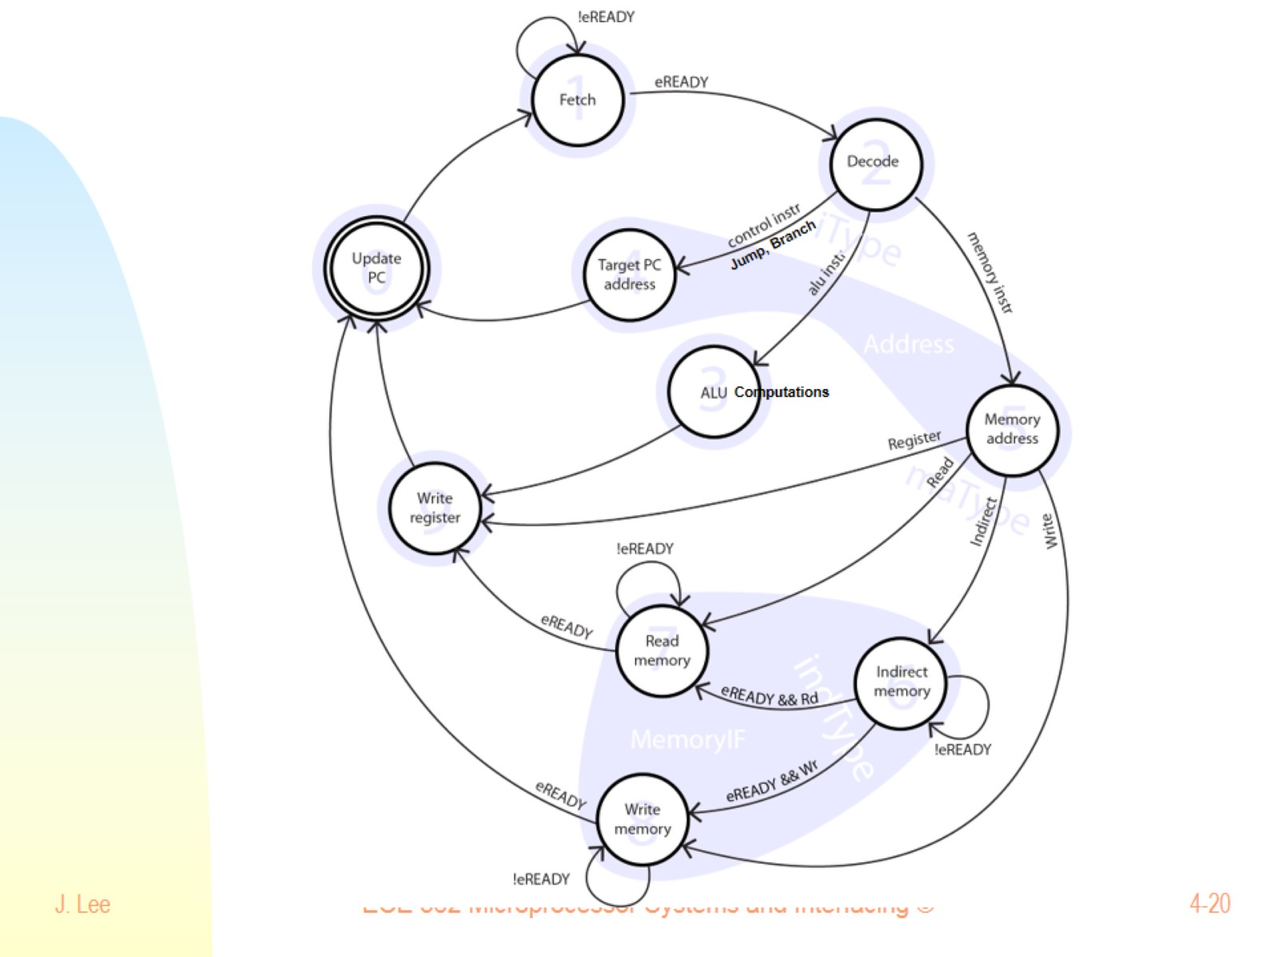

Slide 21
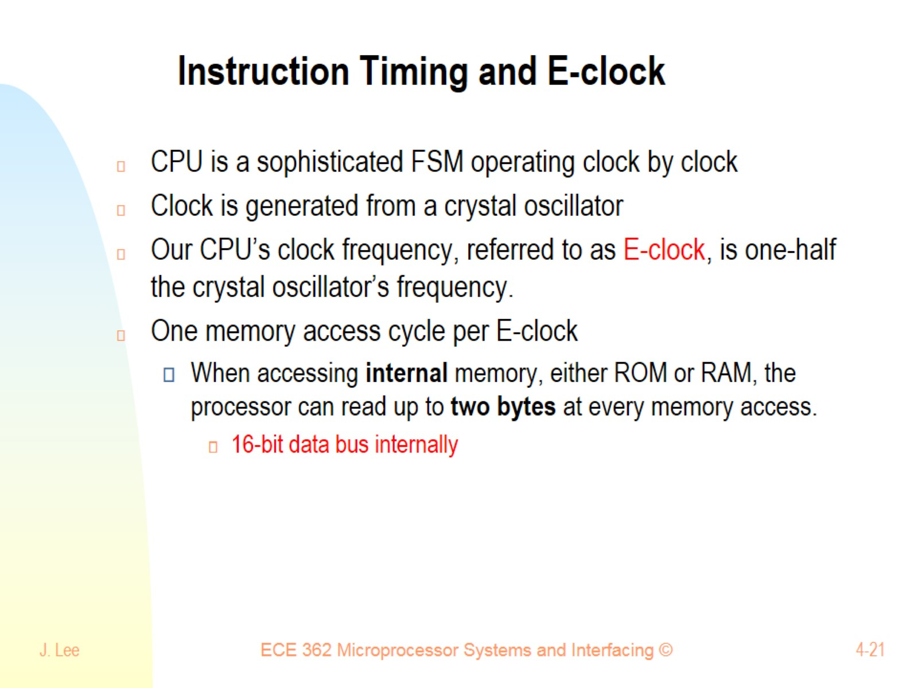
Instruction Timing and E-clock

Slide 22
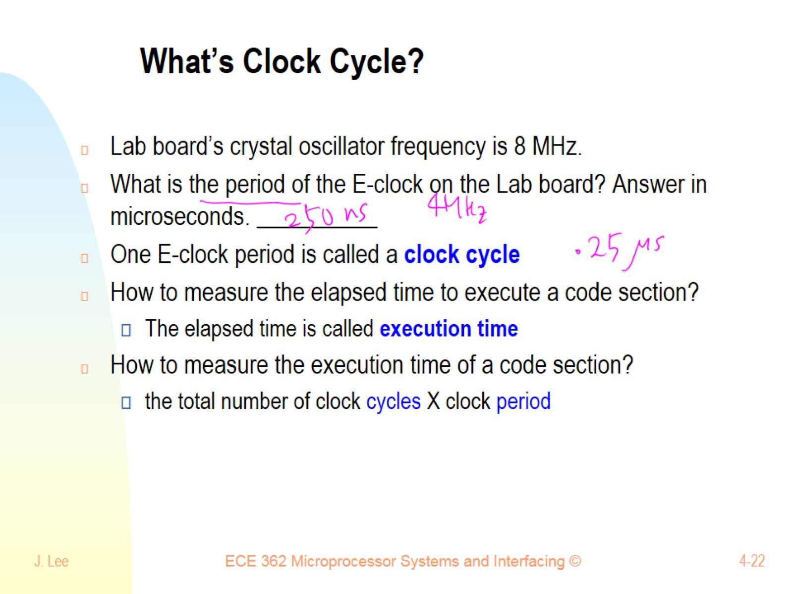
What’s Clock Cycle?

Slide 23
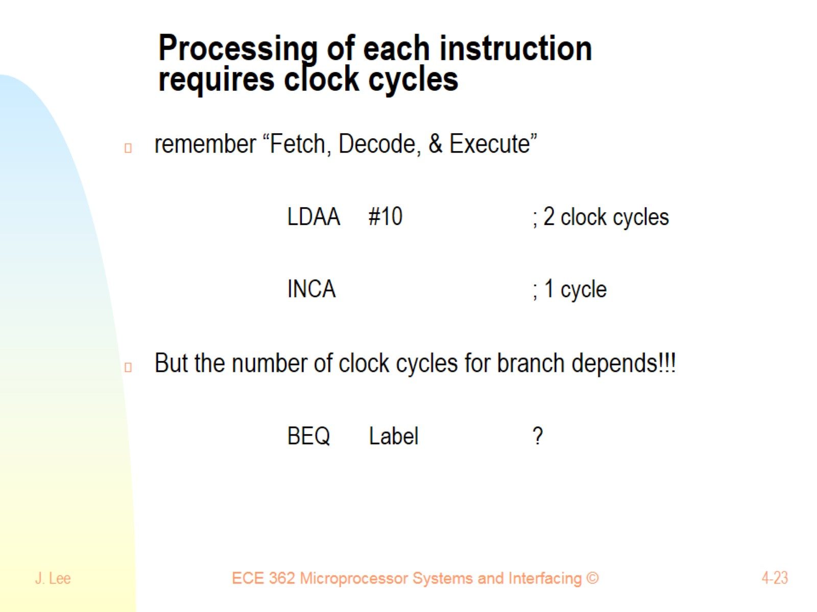
Processing of each instruction requires clock cycles

Slide 24
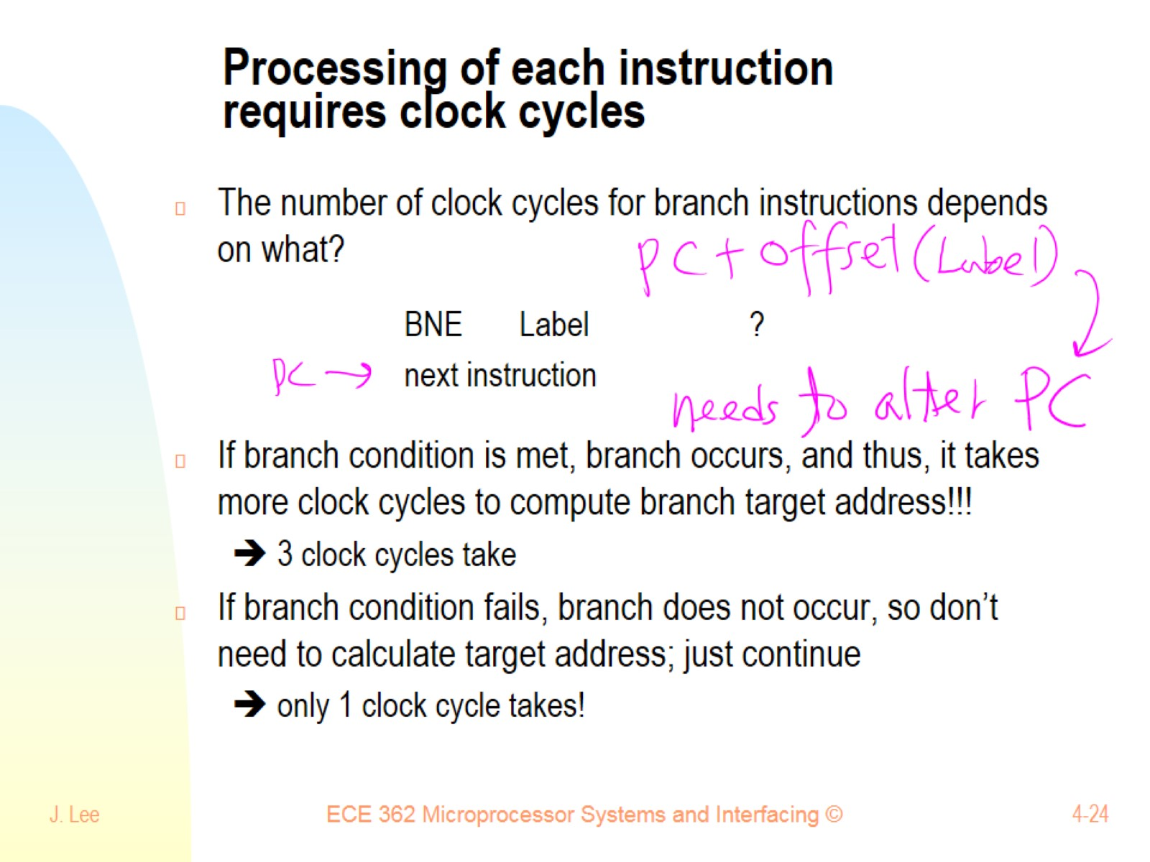
Processing of each instruction requires clock cycles

Slide 25
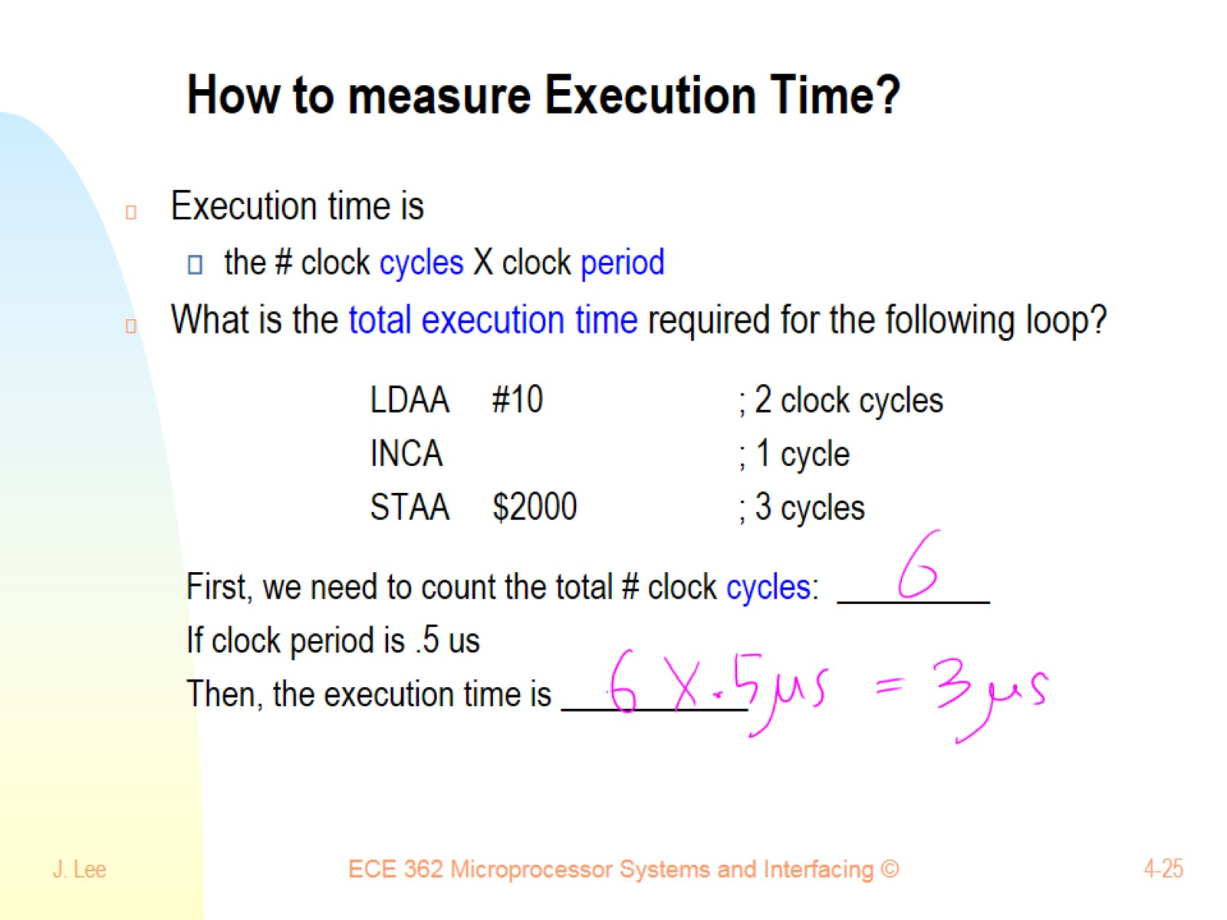
How to measure Execution Time?

Slide 26
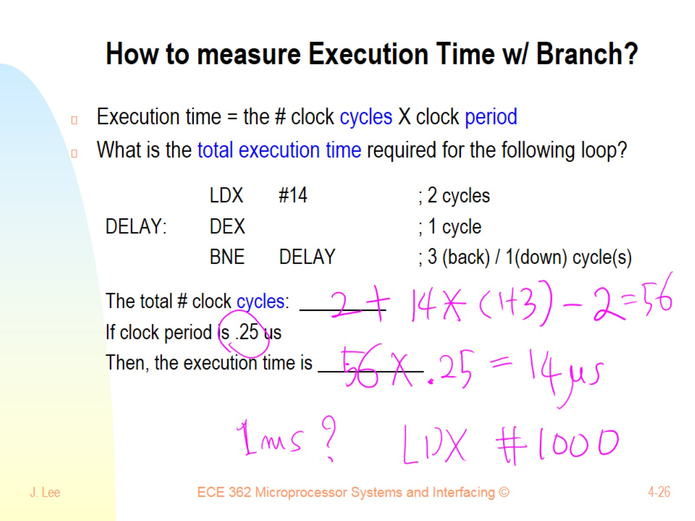
How to measure Execution Time w/ Branch?

Slide 27
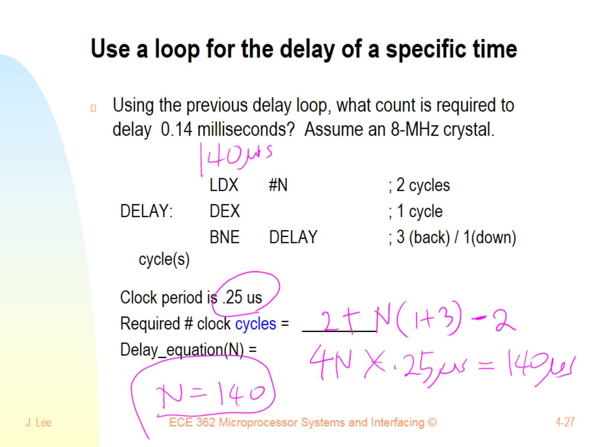
Use a loop for the delay of a specific time

Slide 28
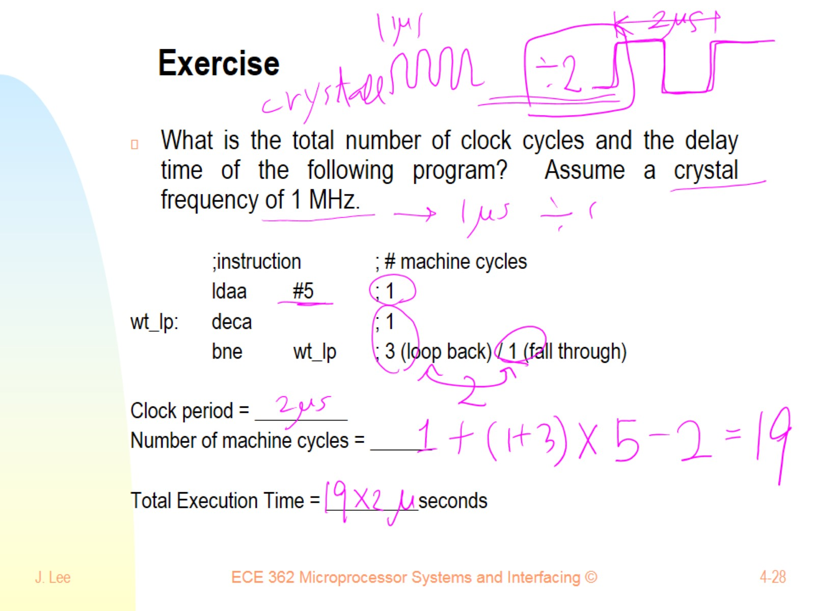
Exercise

Slide 29
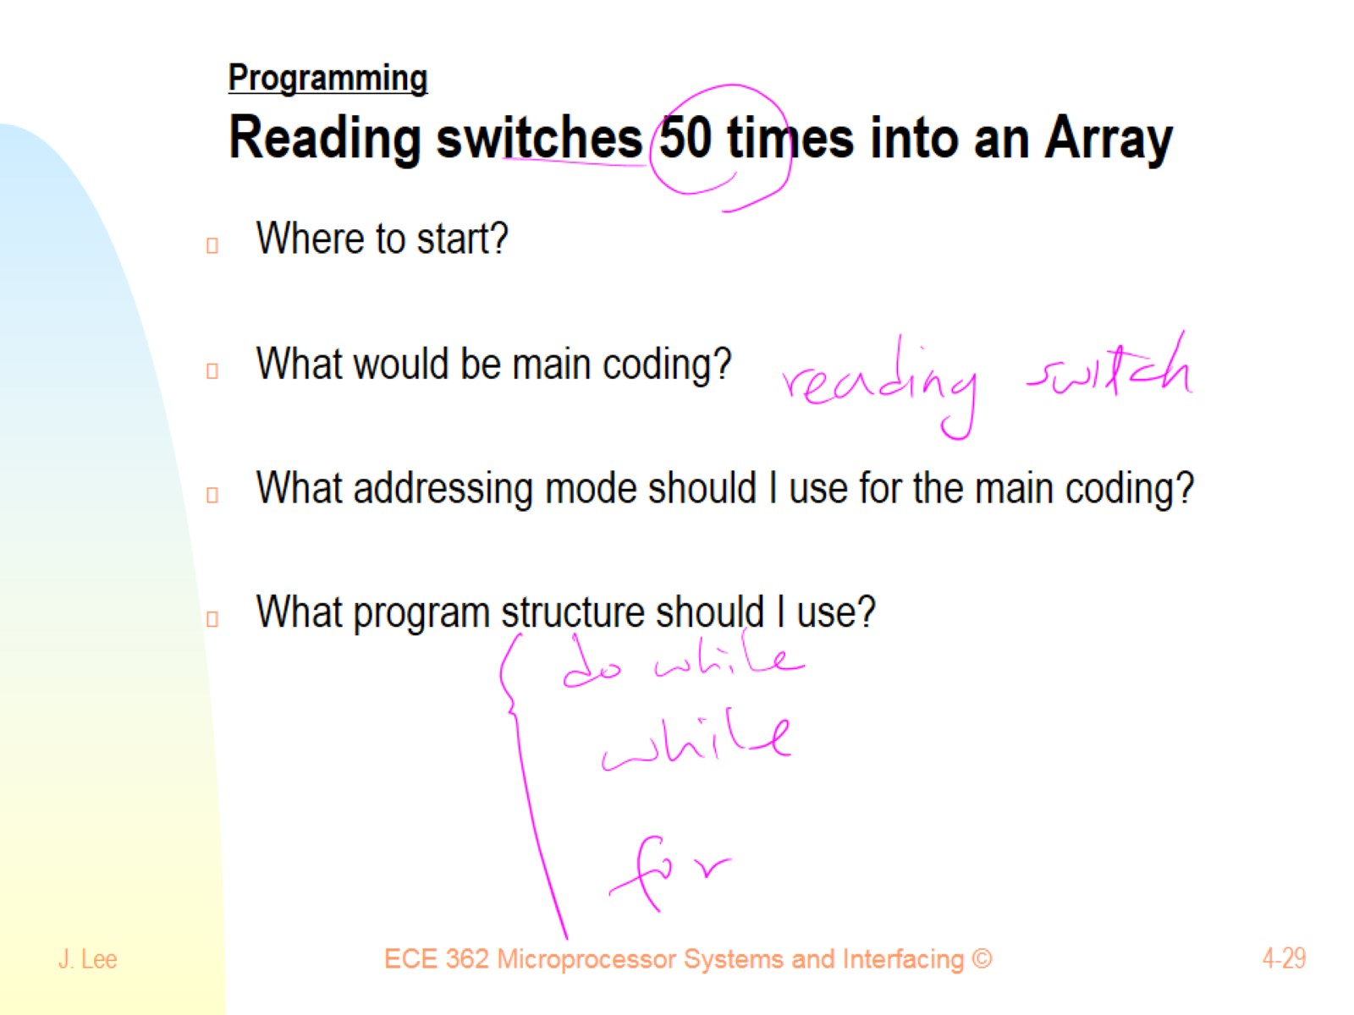
Programming Reading switches 50 times into an Array

Slide 30
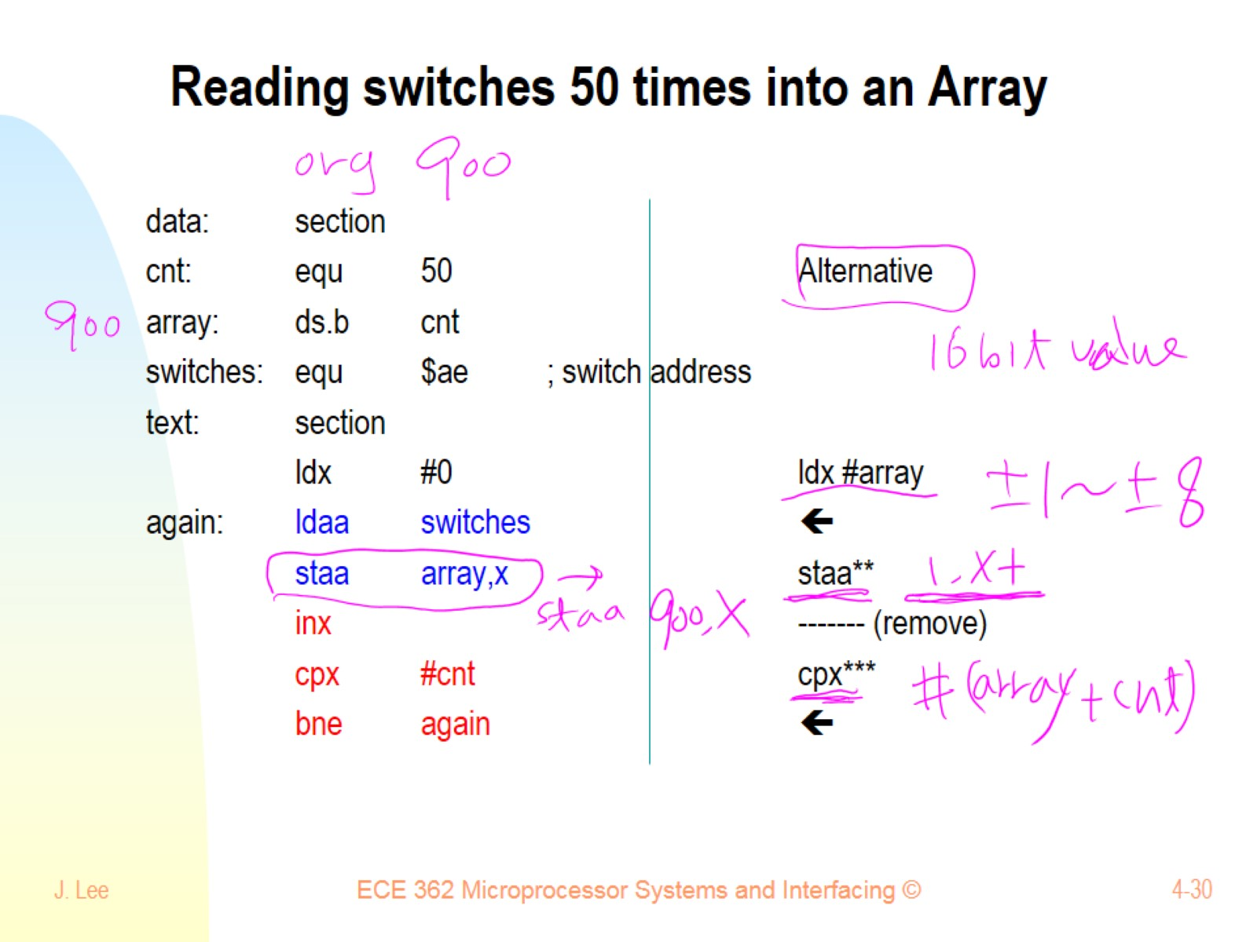
Reading switches 50 times into an Array

Slide 31
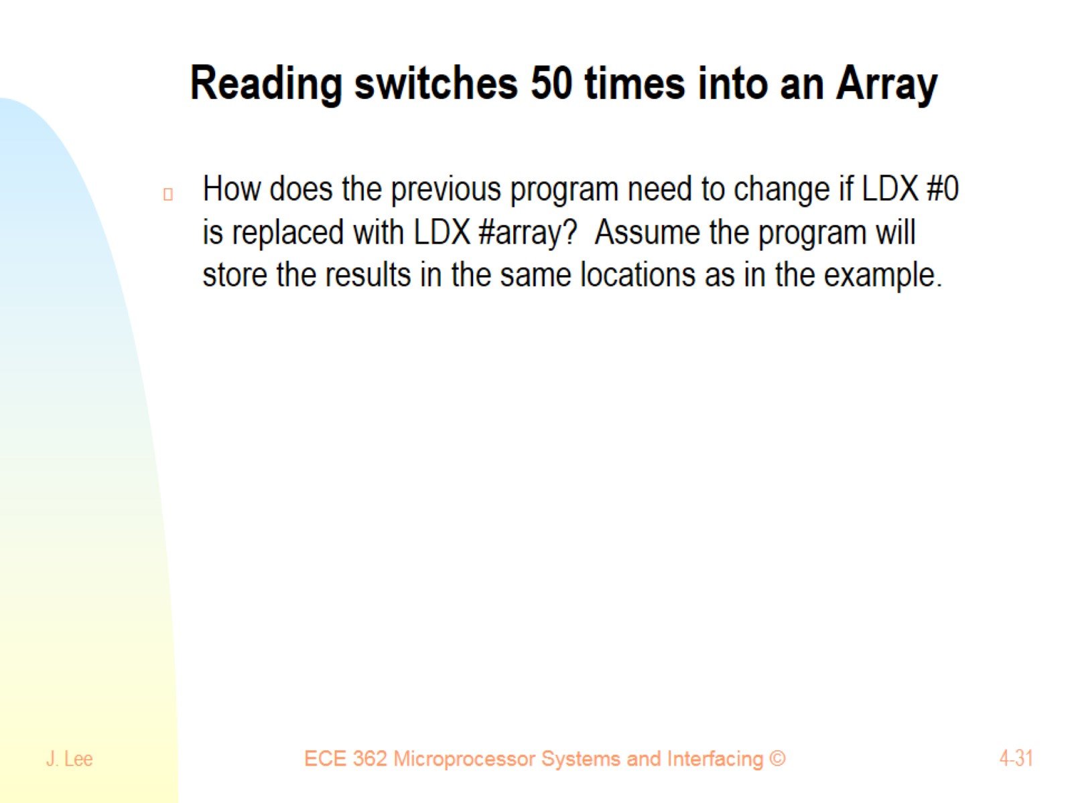
Reading switches 50 times into an Array

Slide 32
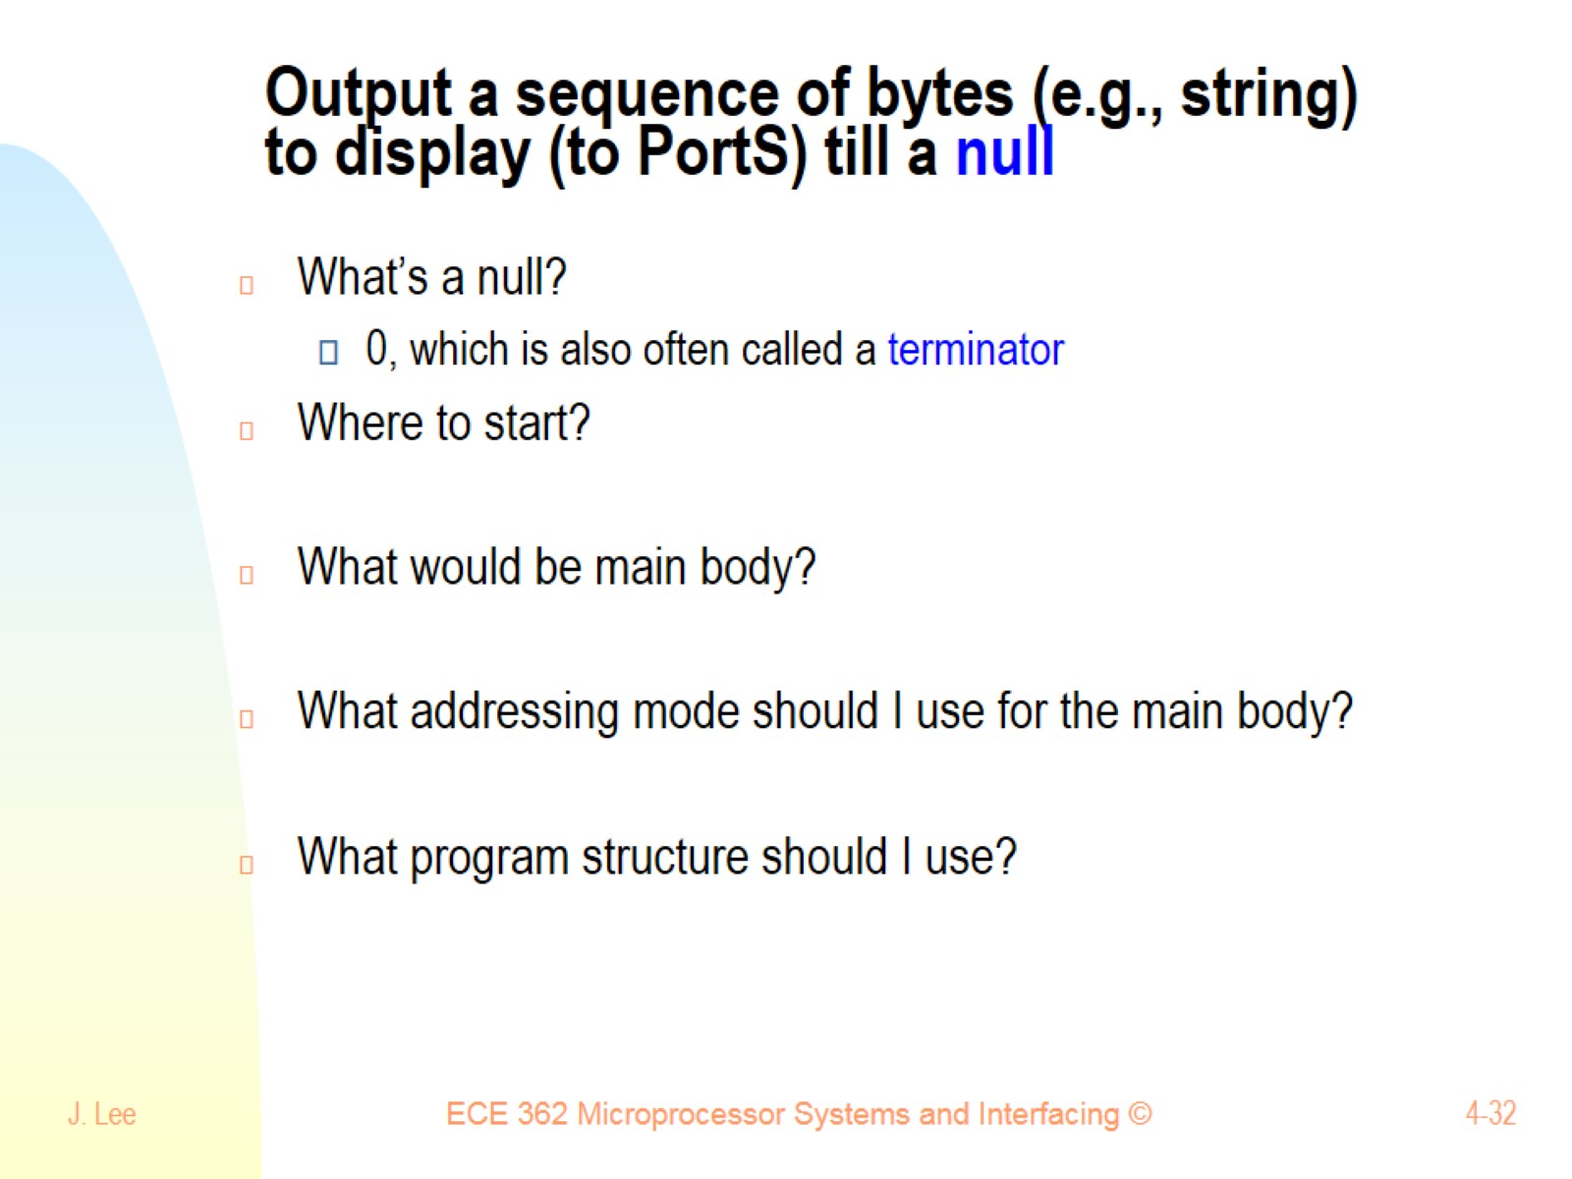
Output a sequence of bytes (e.g., string) to display (to PortS) till a null

Slide 33
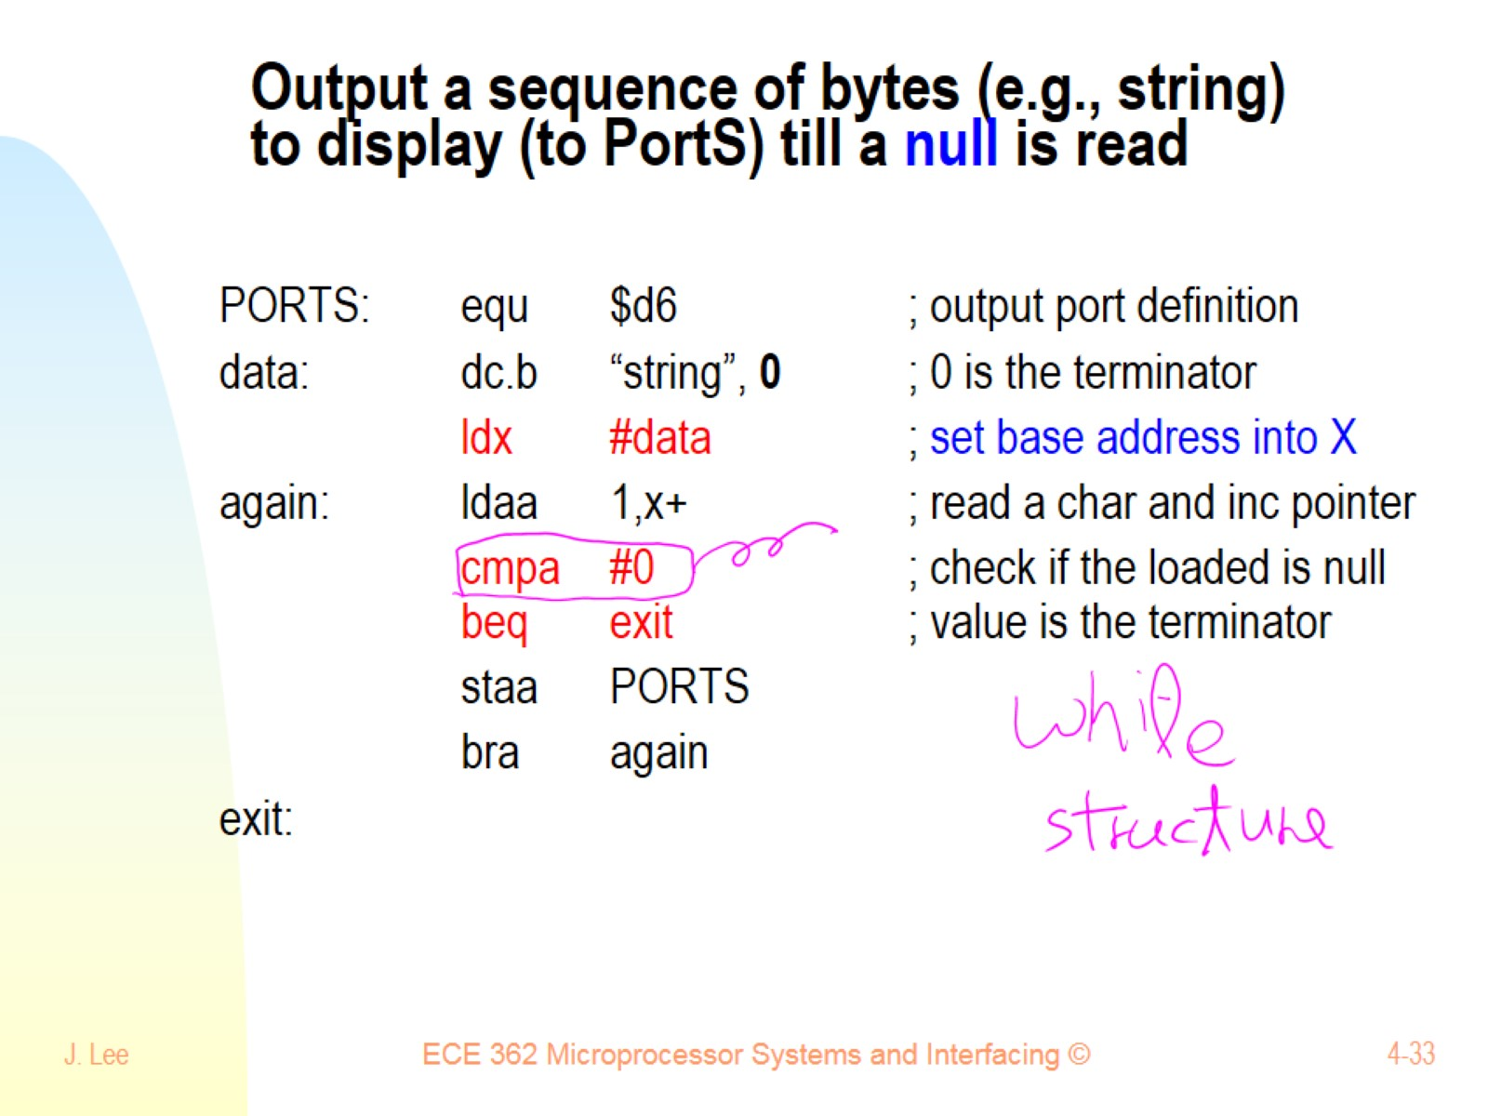
Output a sequence of bytes (e.g., string) to display (to PortS) till a null is read

Slide 34
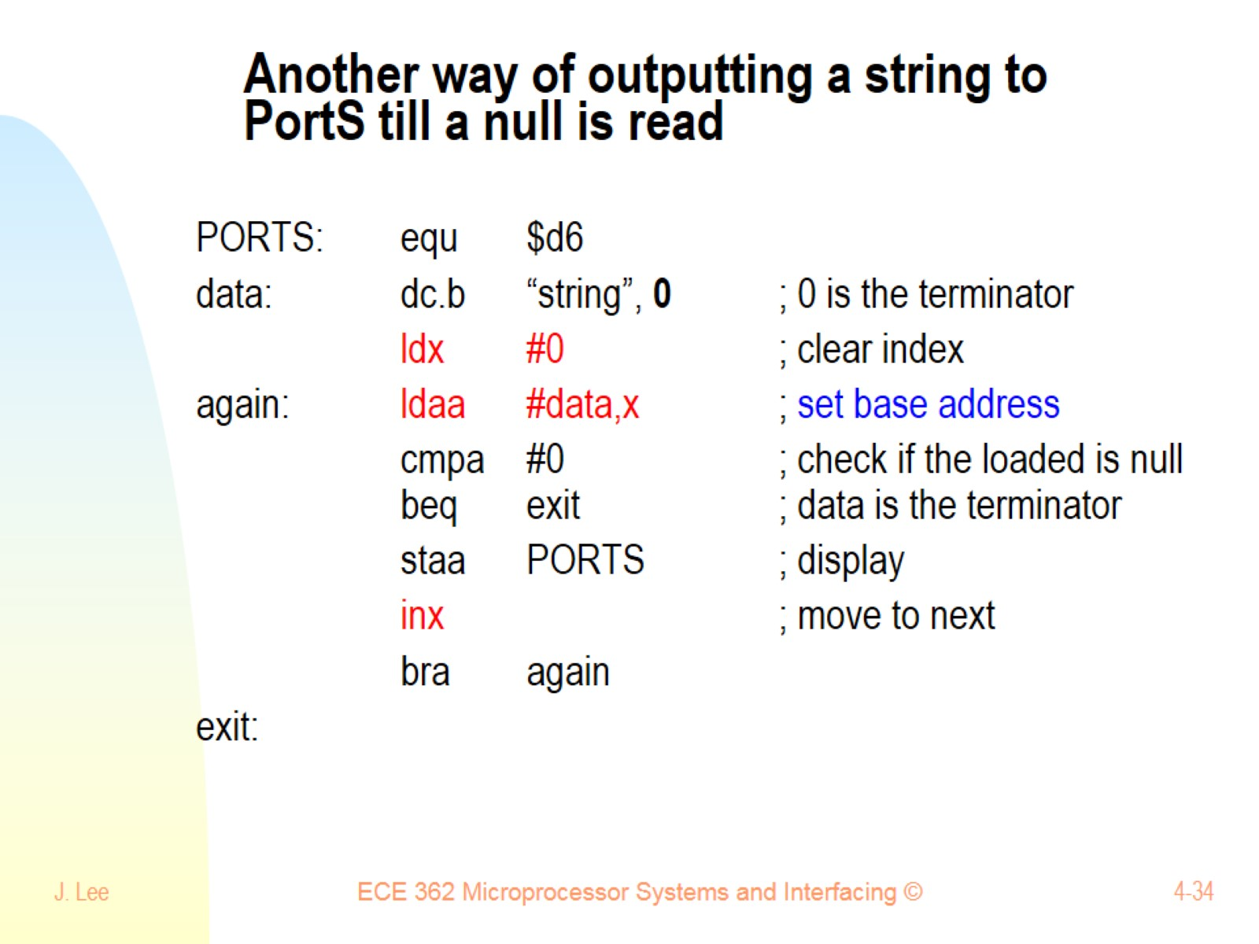
Another way of outputting a string to PortS till a null is read

Slide 35
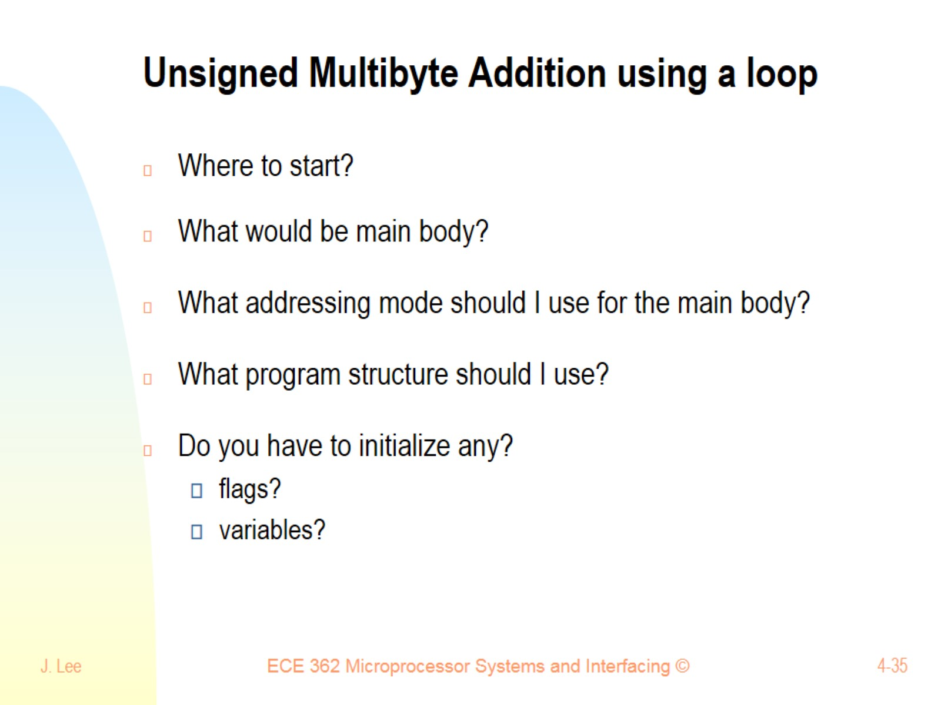
Unsigned Multibyte Addition using a loop

Slide 36
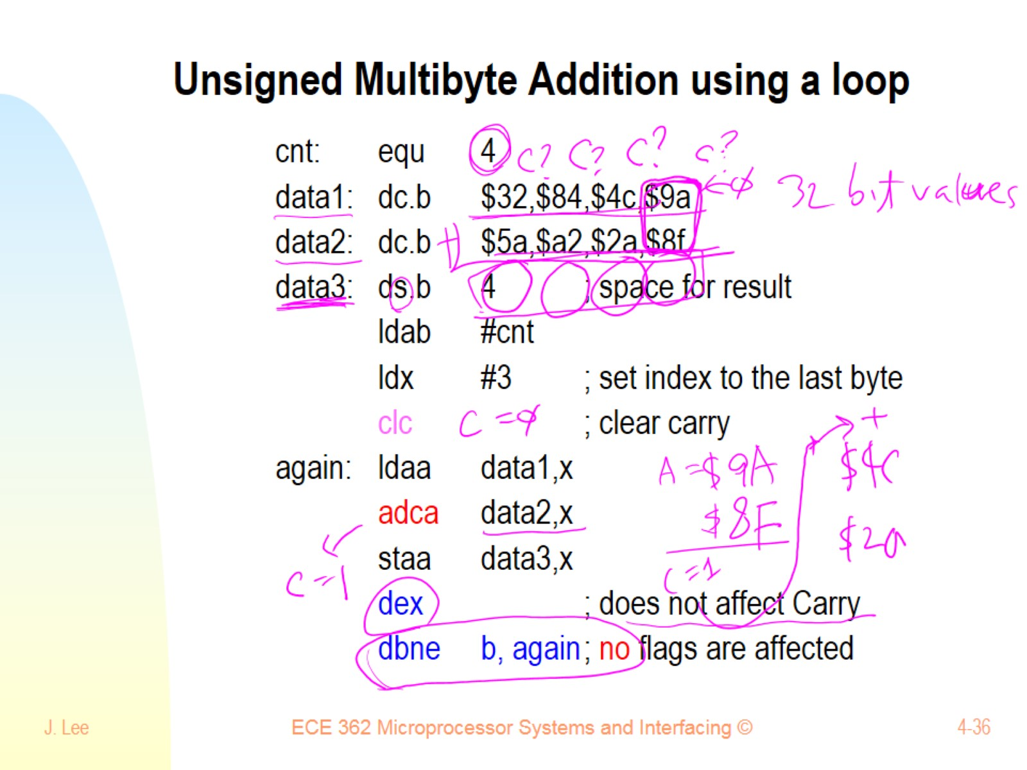
Unsigned Multibyte Addition using a loop

Slide 37
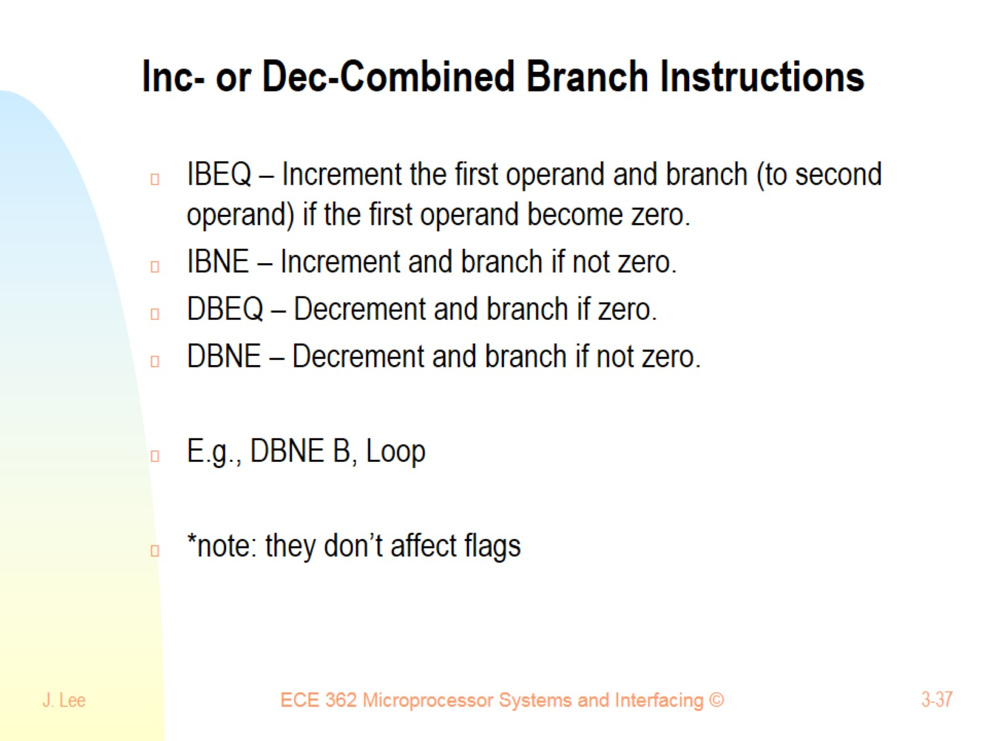
Inc- or Dec-Combined Branch Instructions

Slide 38
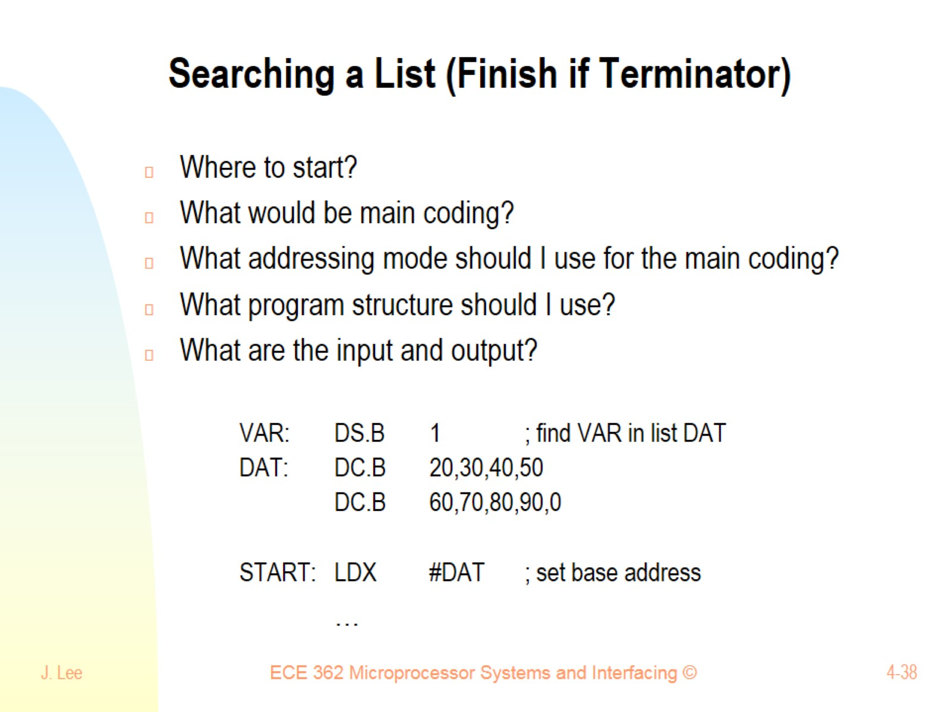
Searching a List (Finish if Terminator)

Slide 39
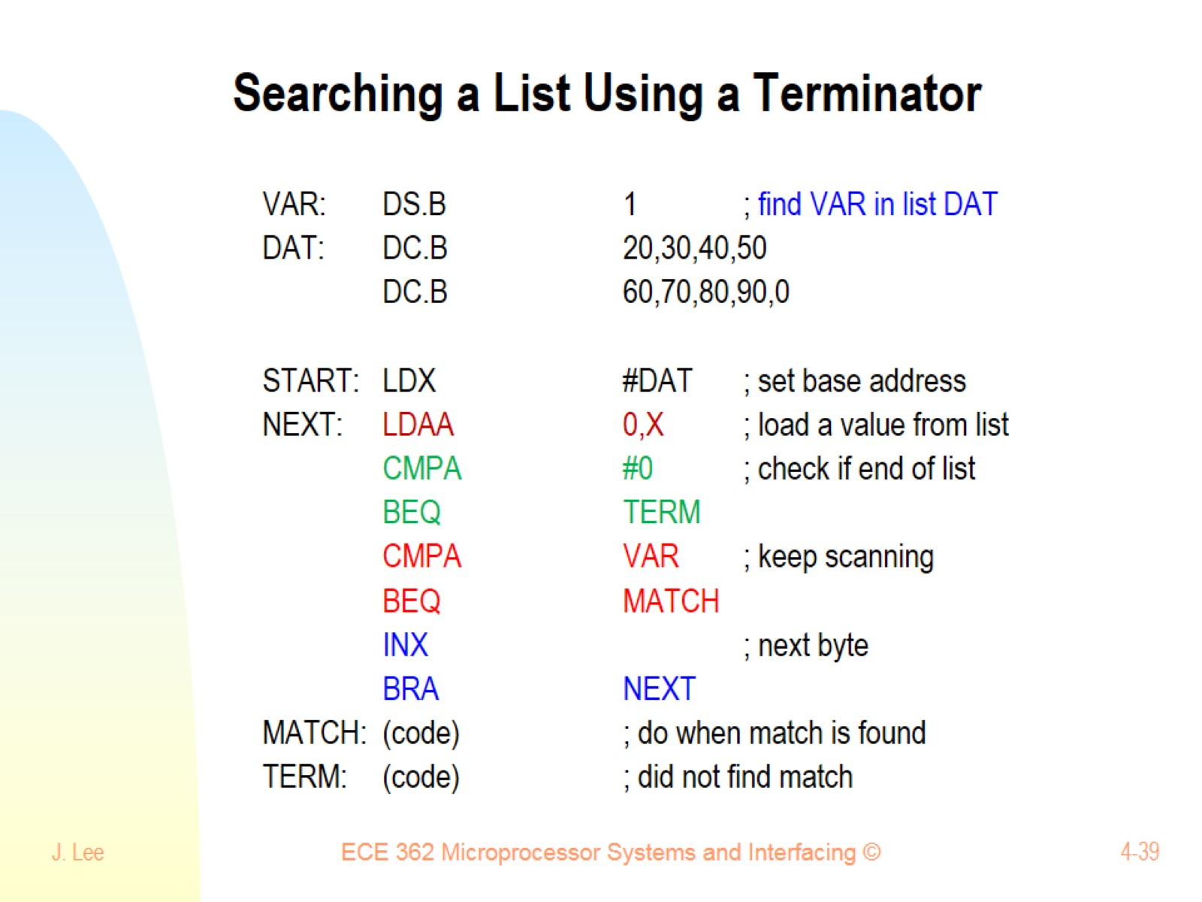
Searching a List Using a Terminator

Slide 40
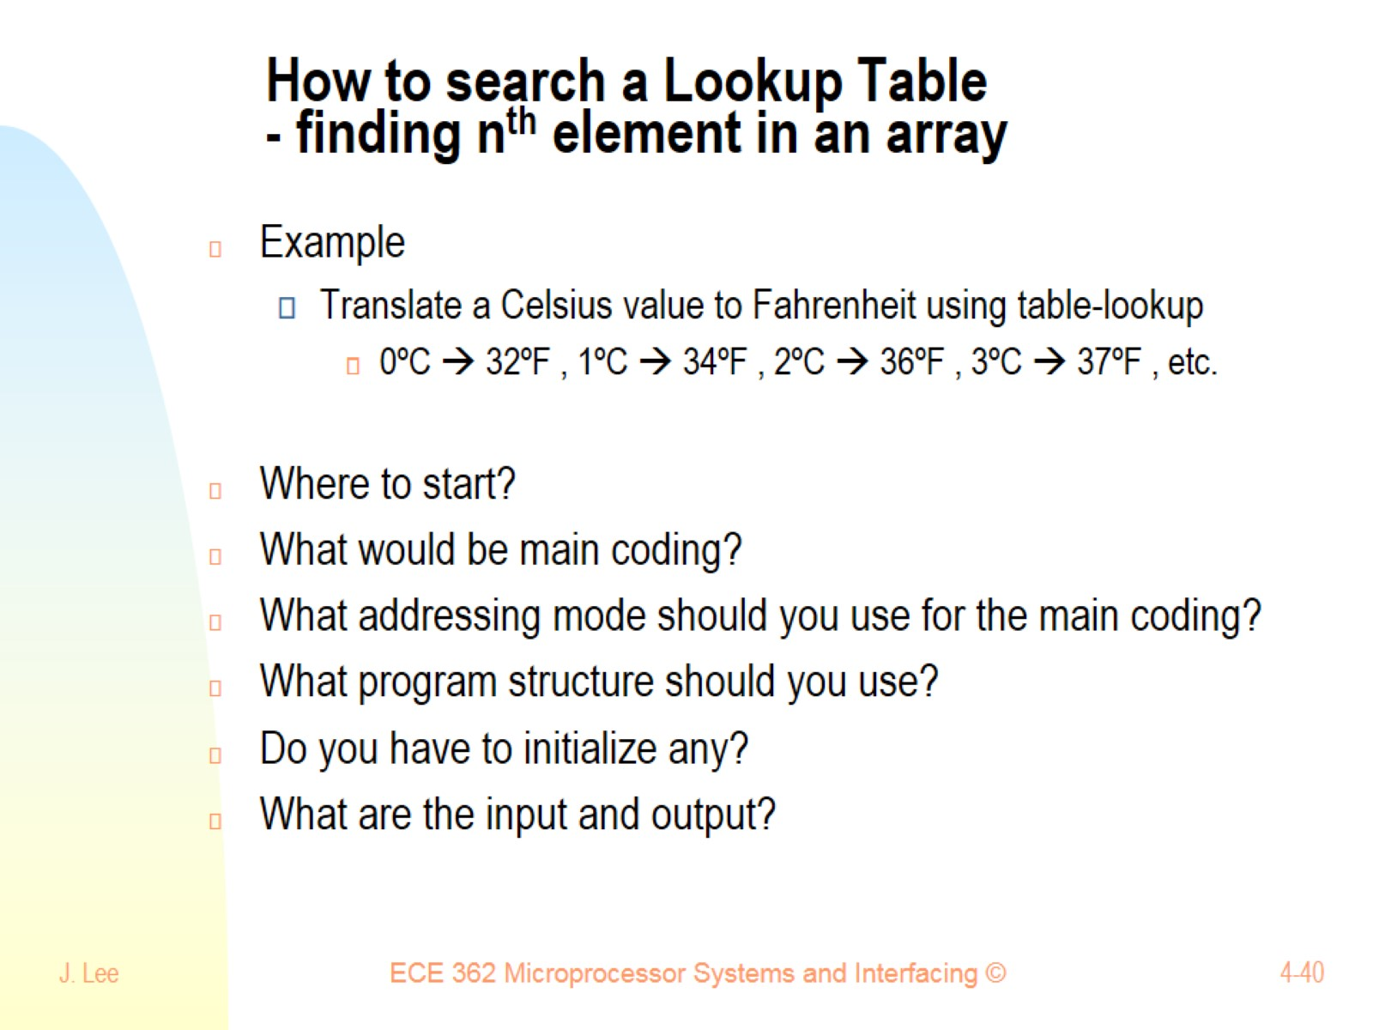
How to search a Lookup Table - finding n^{th} element in an array

Slide 41
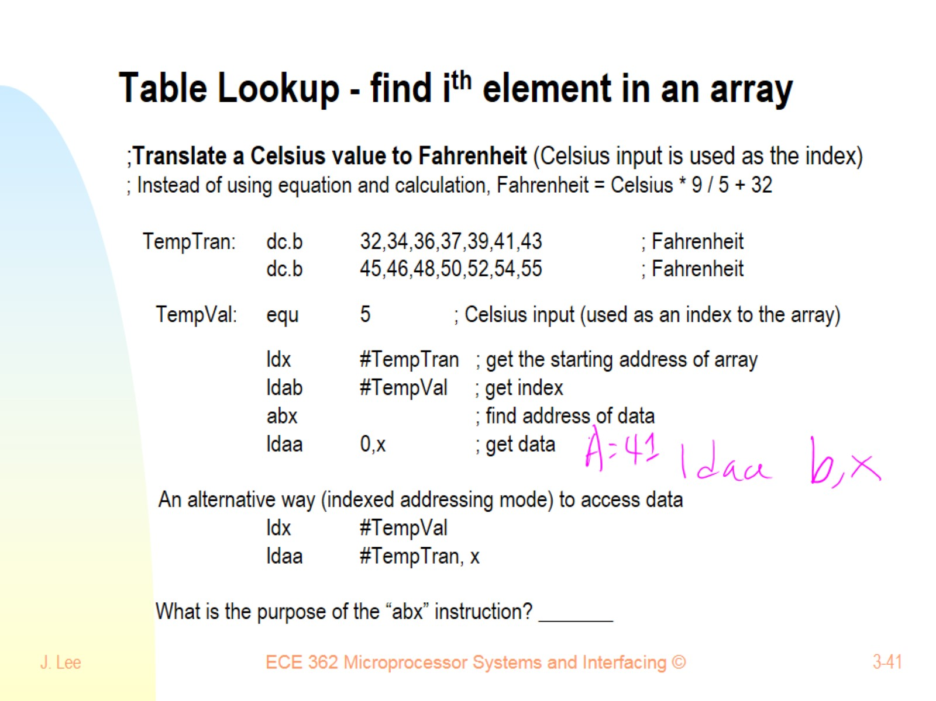
Table Lookup - find i^{th} element in an array

Slide 42
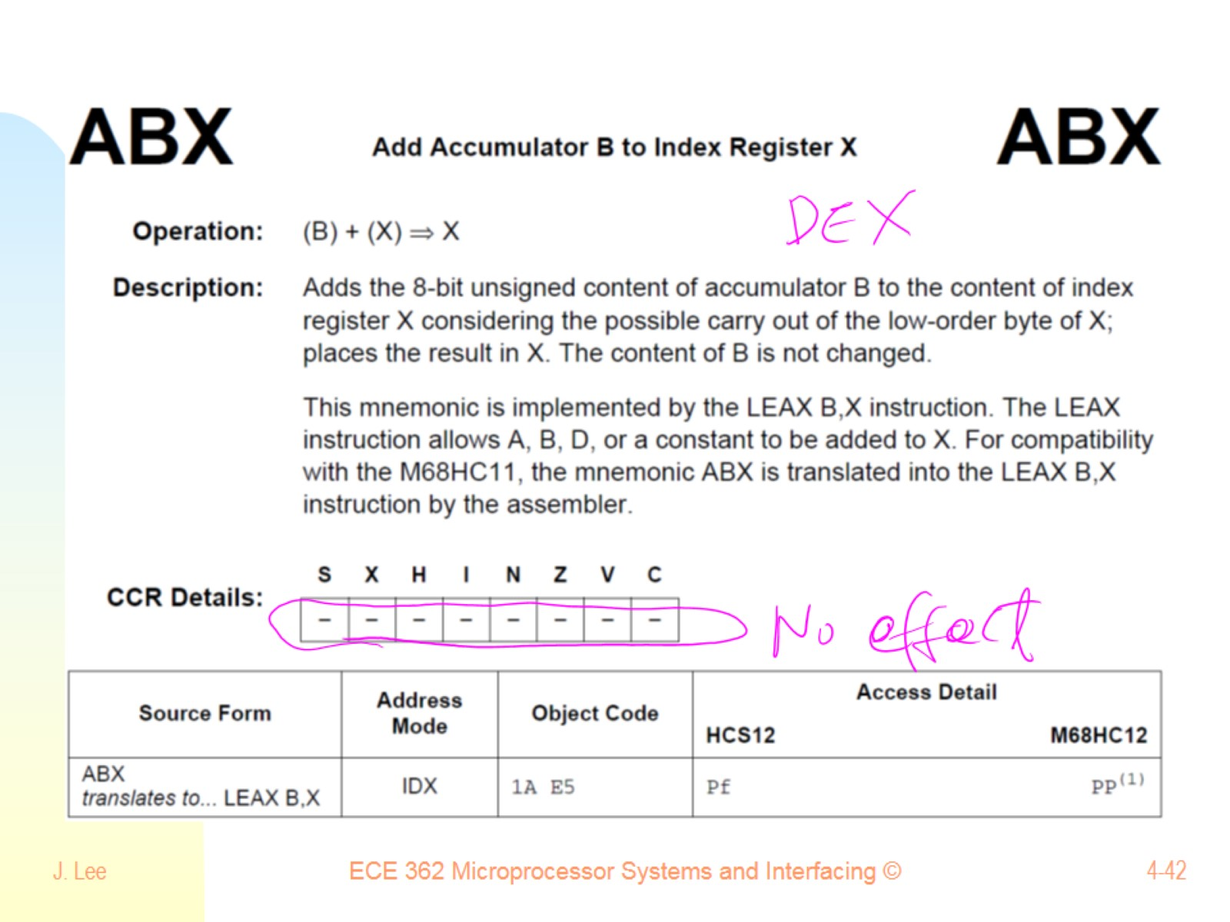

Slide 43
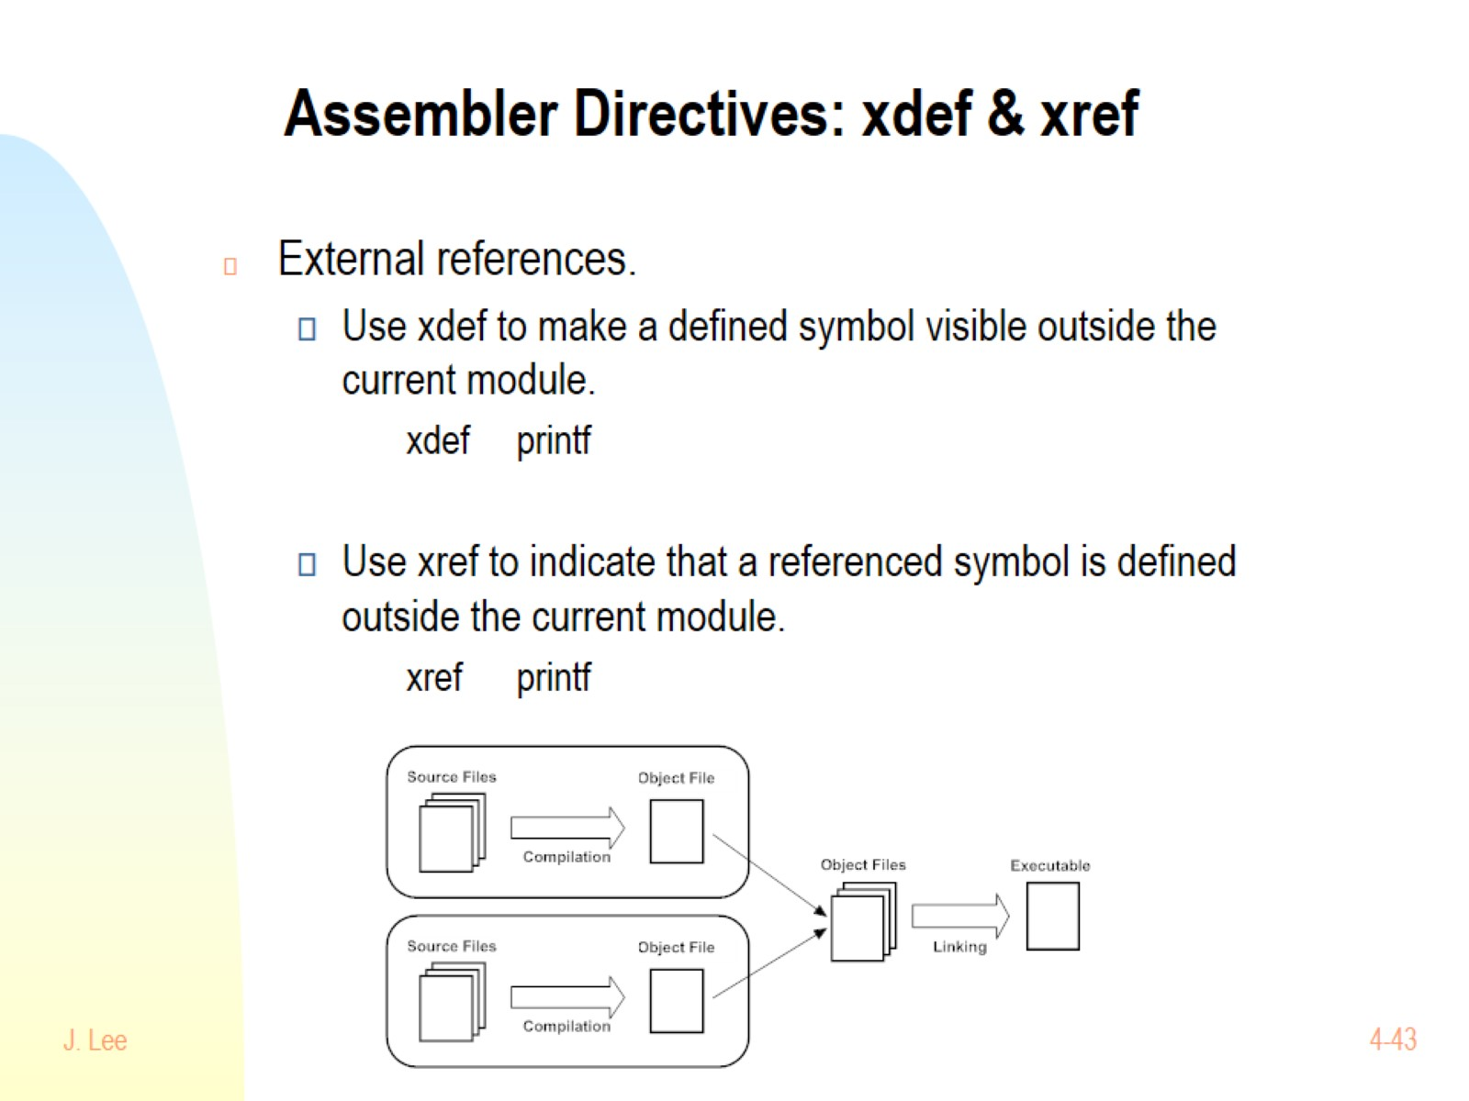
Assembler Directives: xdef & xref

